Slide 1

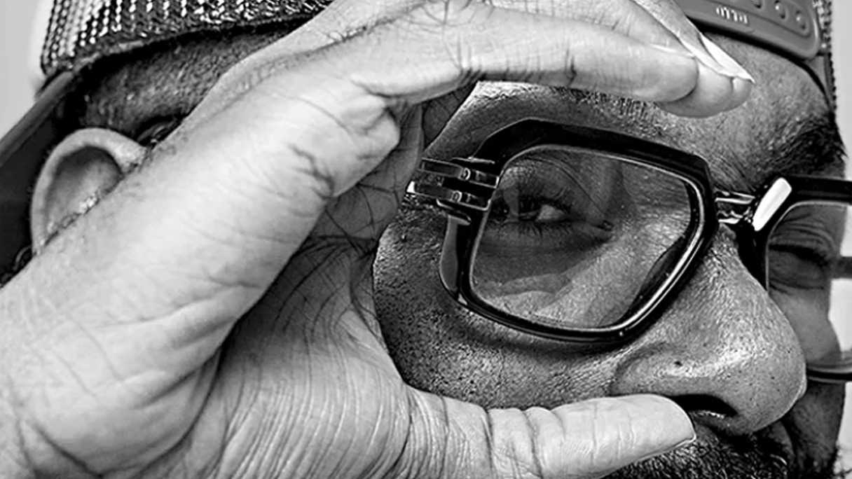

ICHM Study Abroad Program 2022/2023
CRICO Code 075806G
Notes:
Photo cover – image can be swapped out.

Slide 2
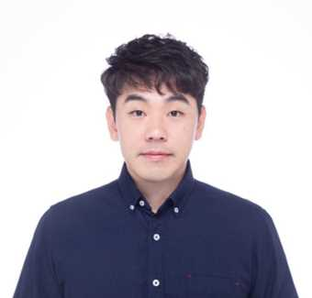

Joey Wang
Regional Recruitment Manager
of HK, Macau, Japan and Taiwan
E X P E R I E N C E
Study Group
Partner Sales Manager
Arizona State University
Business Development Executive
TDCX (FACEBOOK)
Subject Matter Expert
International Cooperation and Development Fund
Project Manager
StarKist
Fleet Coordinator
E D U C A T I O N
University of London SOAS
Master degree, Pacific Asian Studies
ヒューマンアカデミー
Businese Japanese Certificate
Tamkang University
Bachelor, History of Art
2

Slide 3



Voted as
Australia’s best hotel & hospitality business school for the quality of its students experiences and teaching quality (QILT, SES 2020)
Established in 1992 with 30 years of Excellence
3

Slide 4
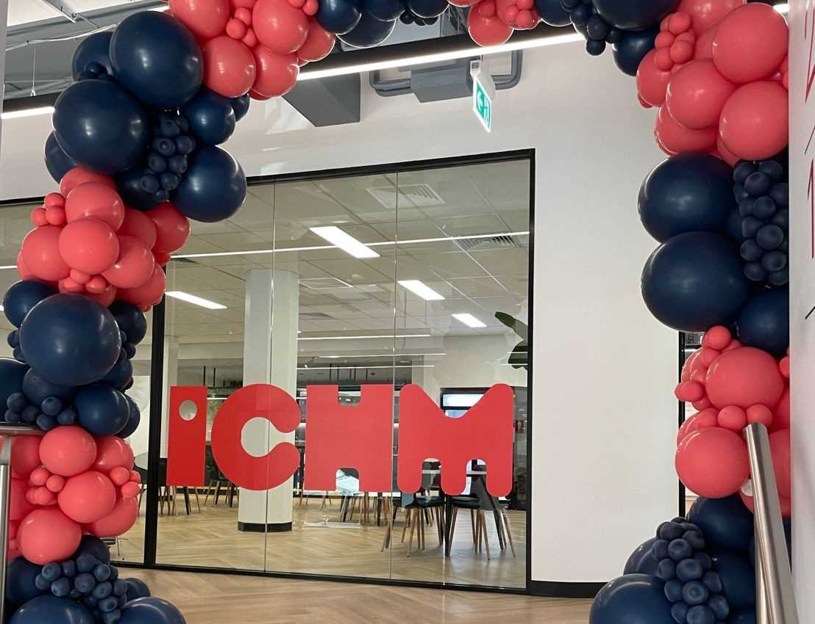
Ranked 2 in overall employment rate
ICHM Graduate employment rate 96.3%
( by QILT Graduate Outcome Survey , GOS 2021)

Slide 5

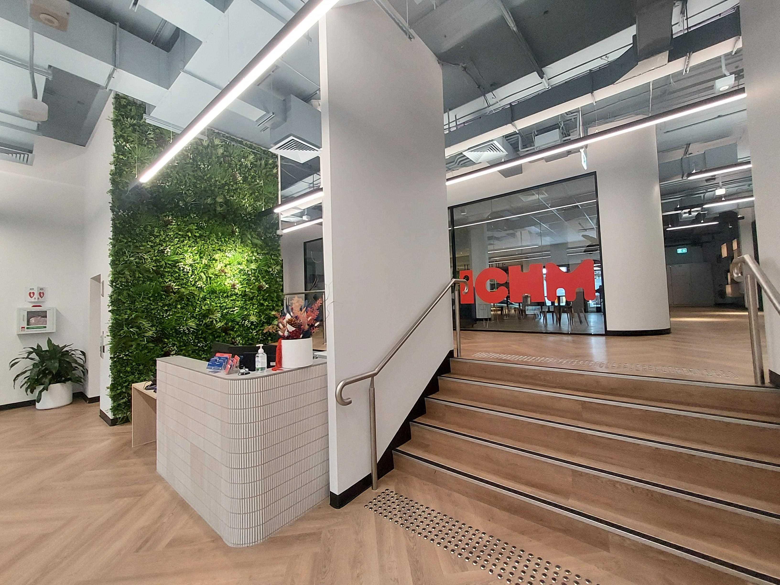
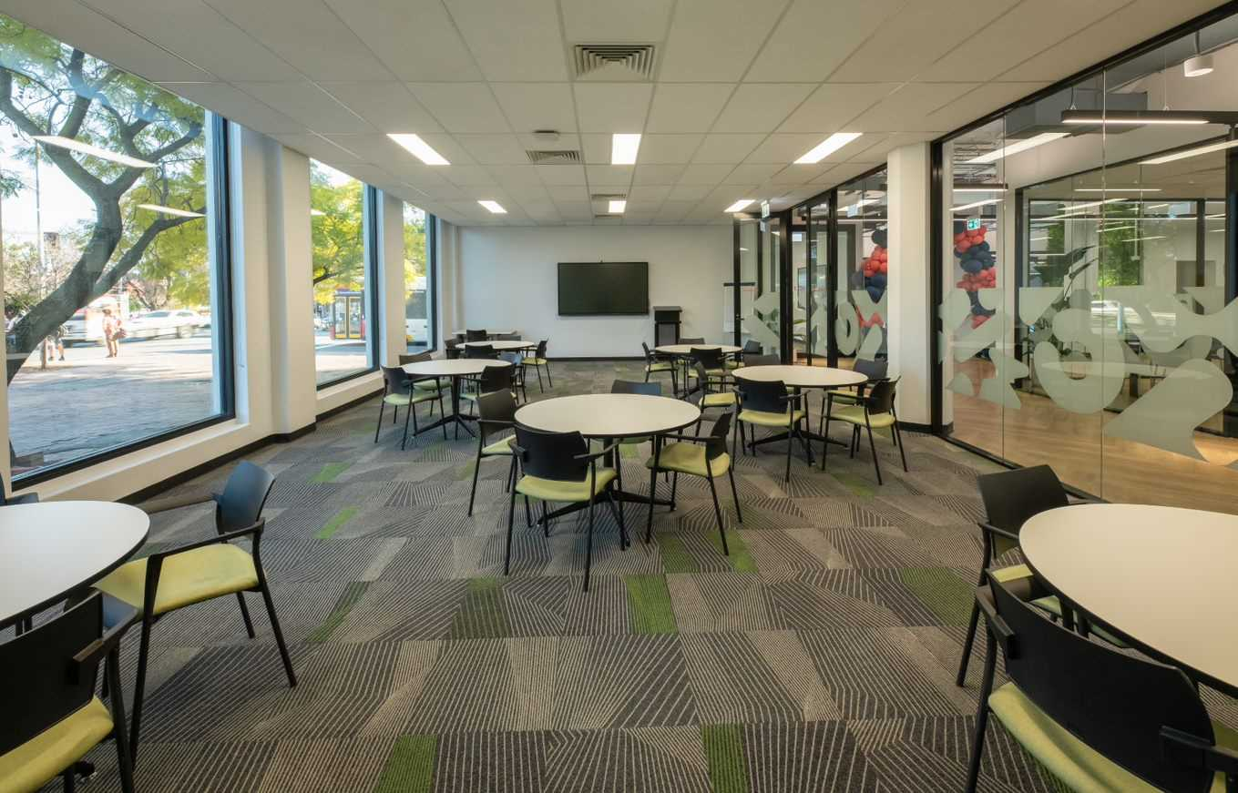
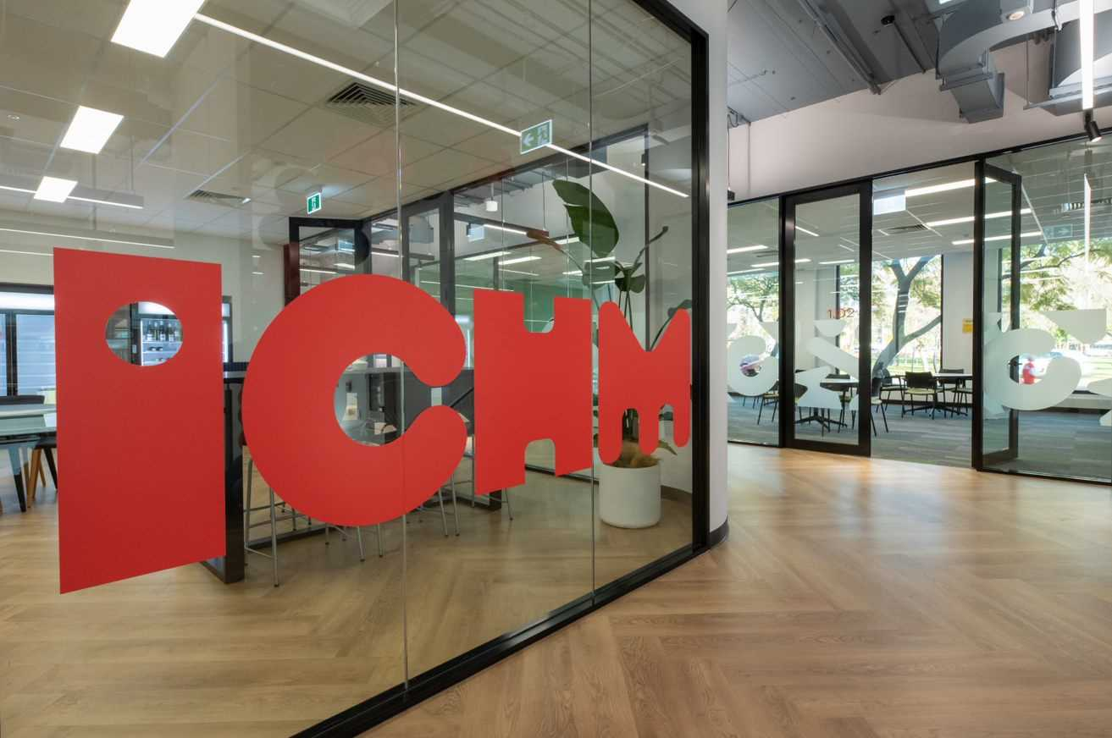
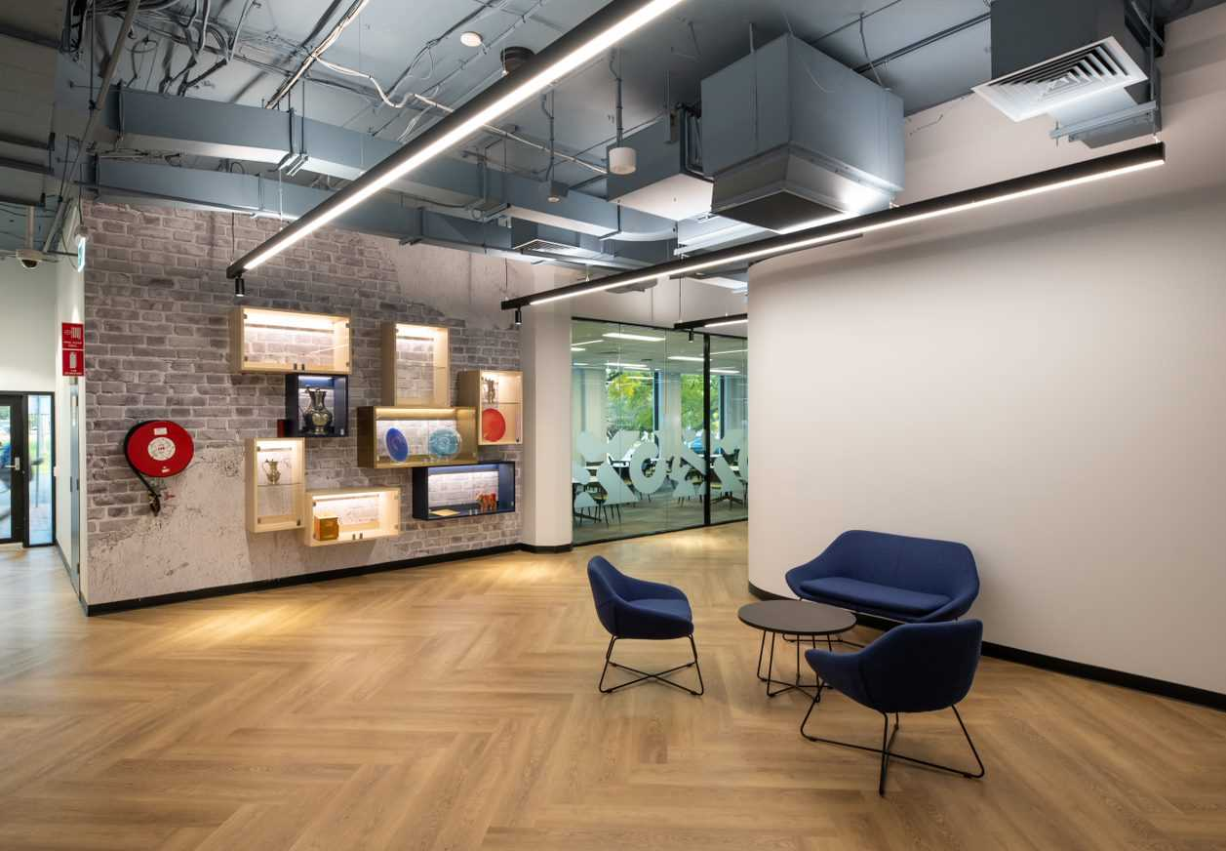
ICHM New Accommodation:
Scape Waymouth
5

Slide 6
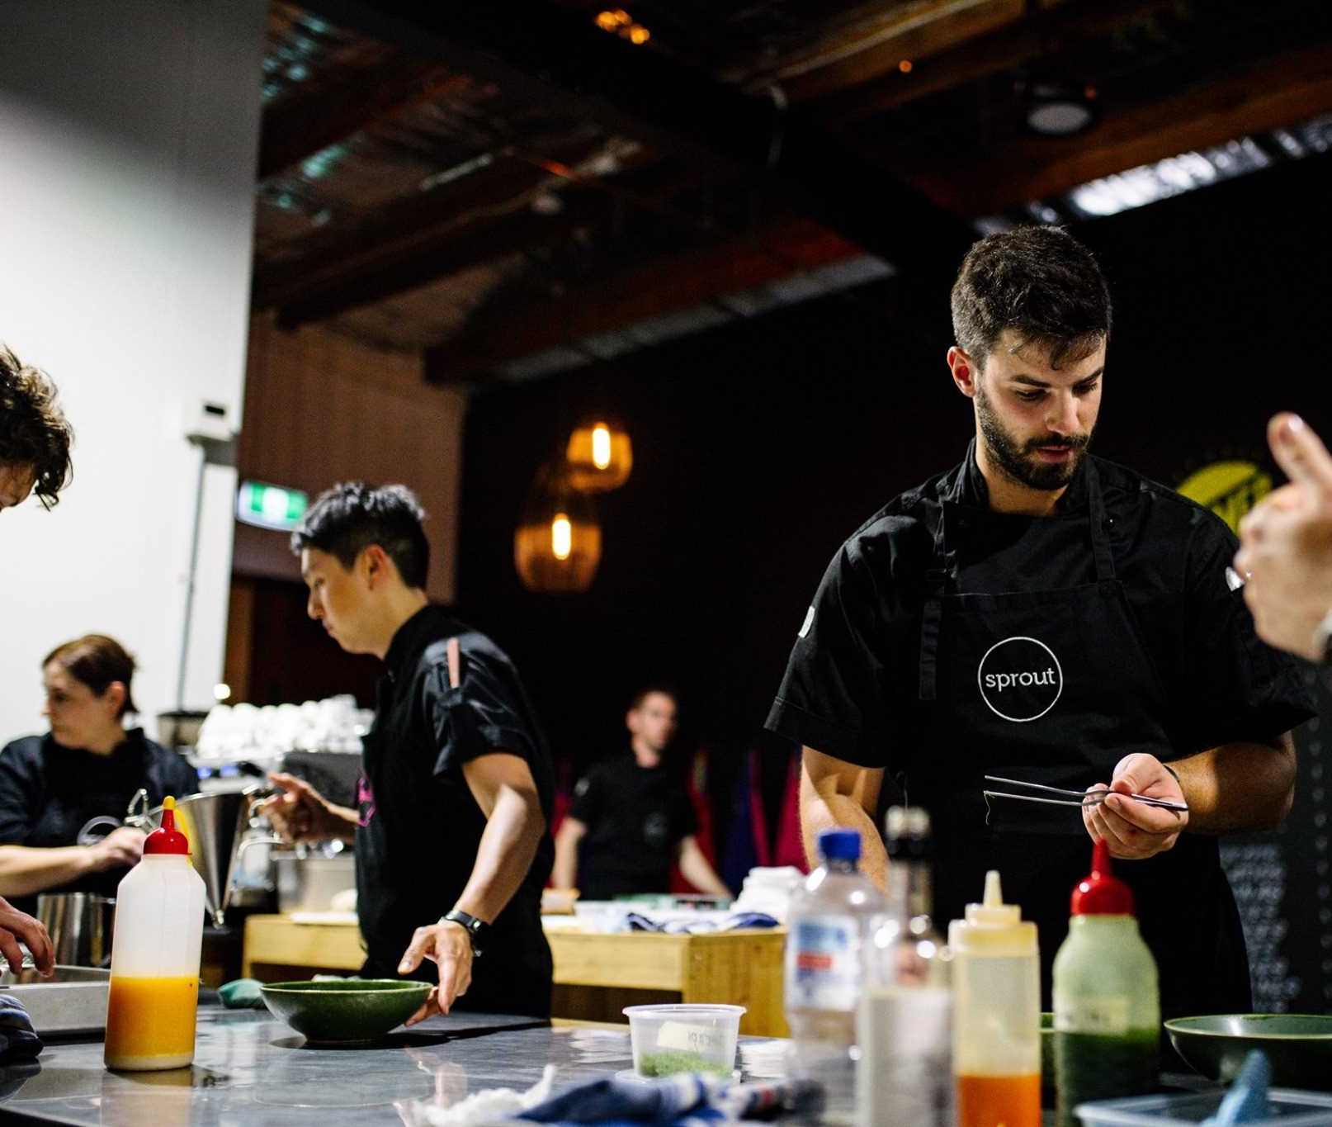
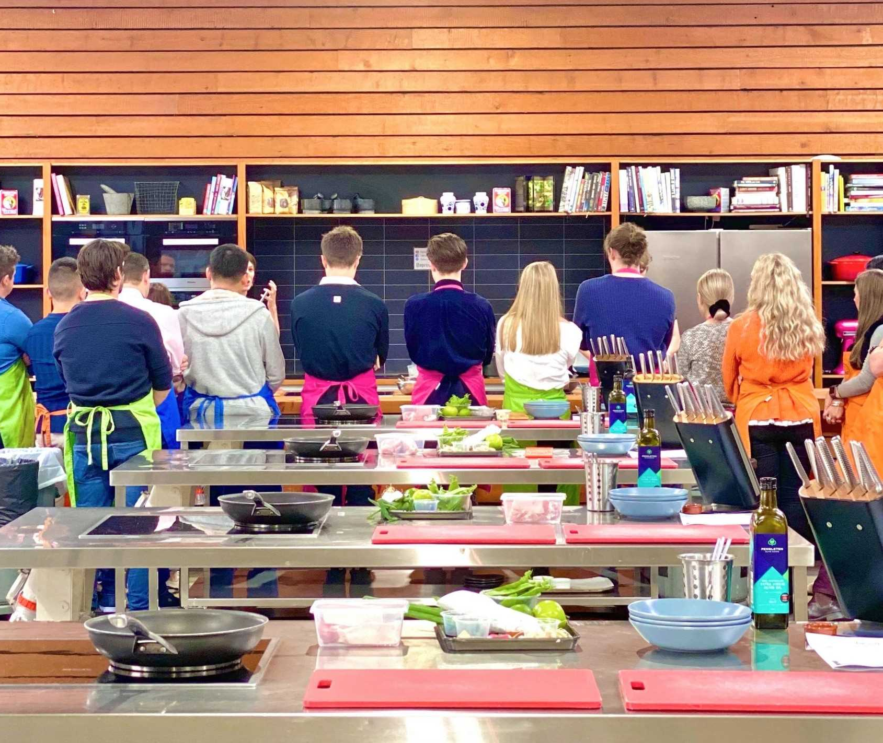
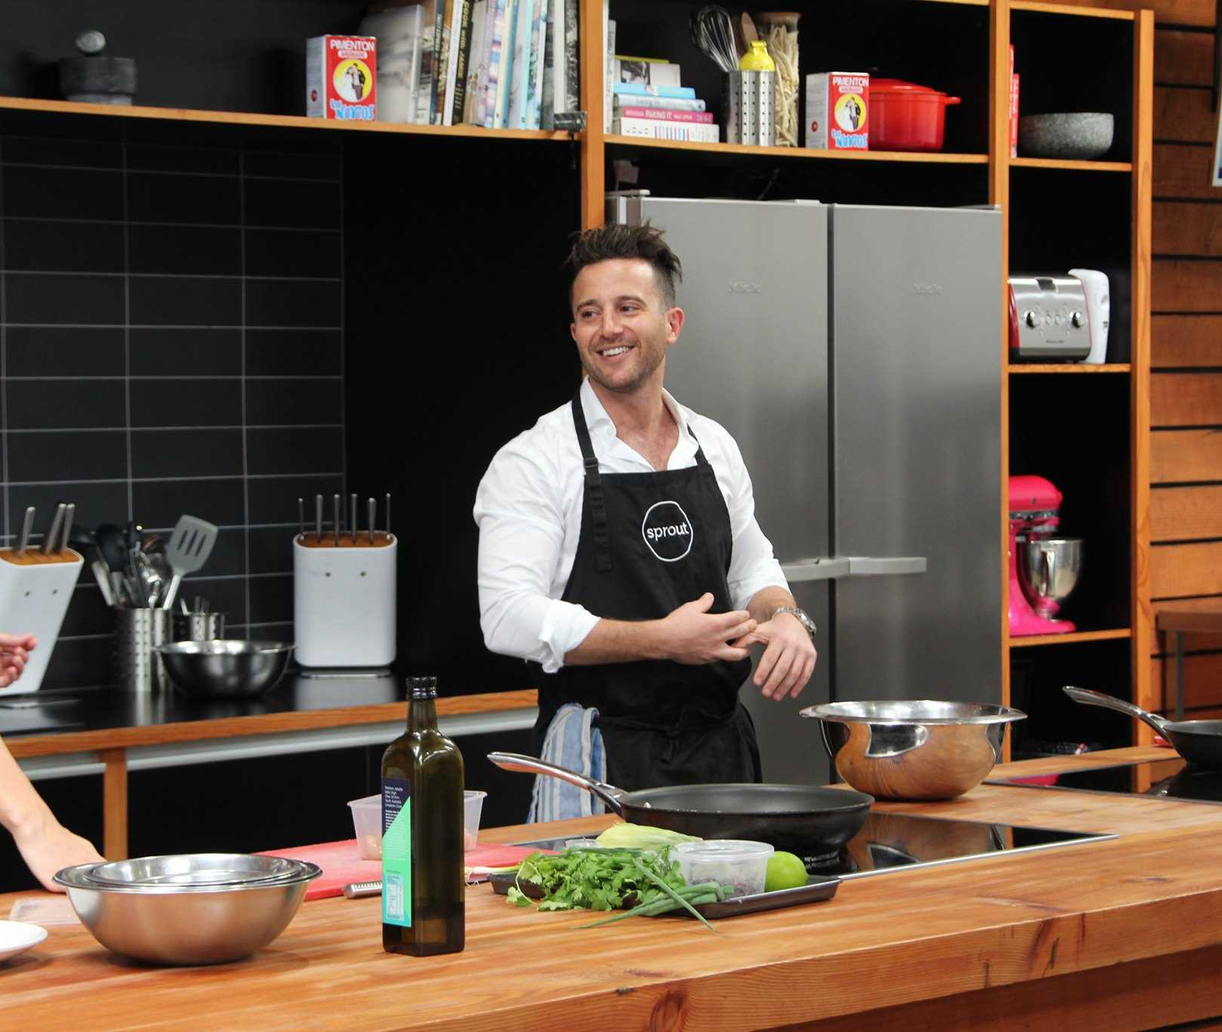
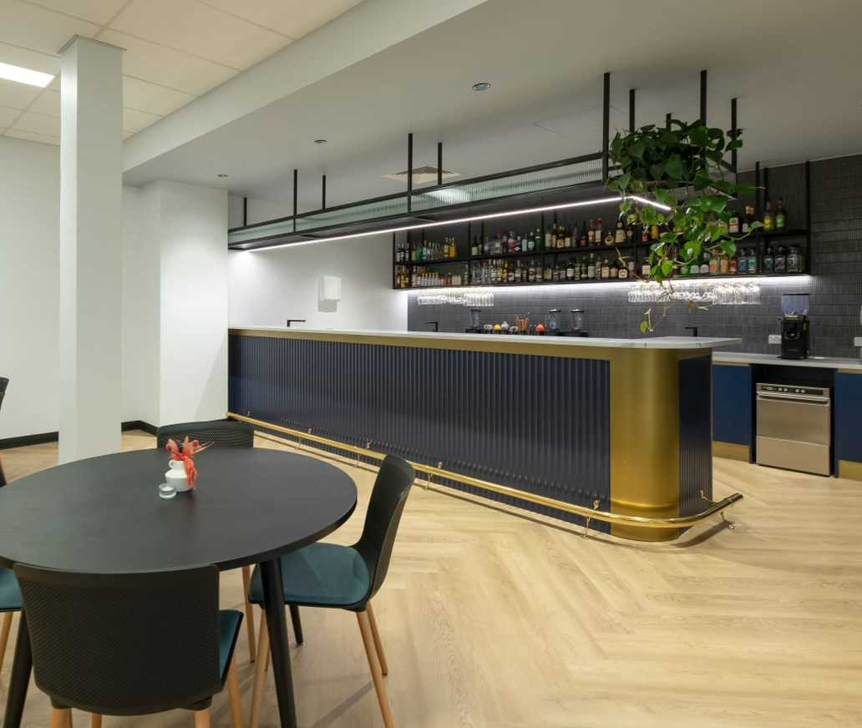
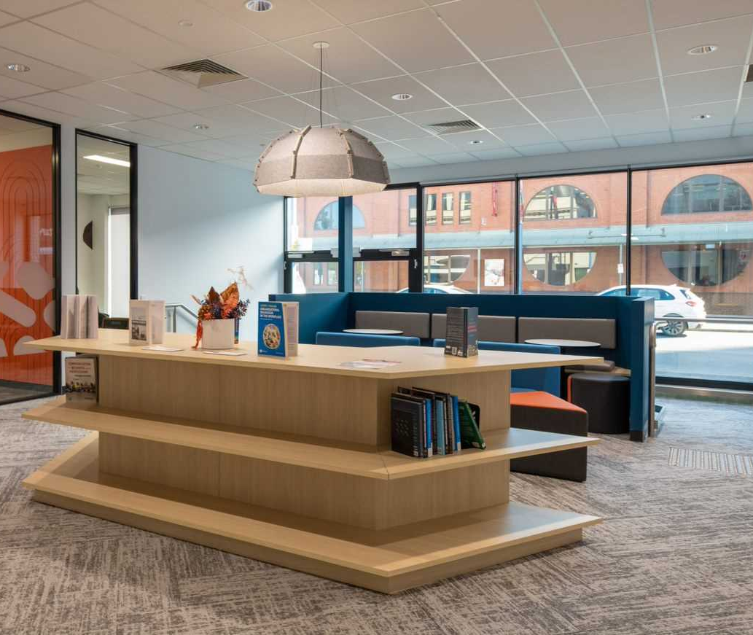
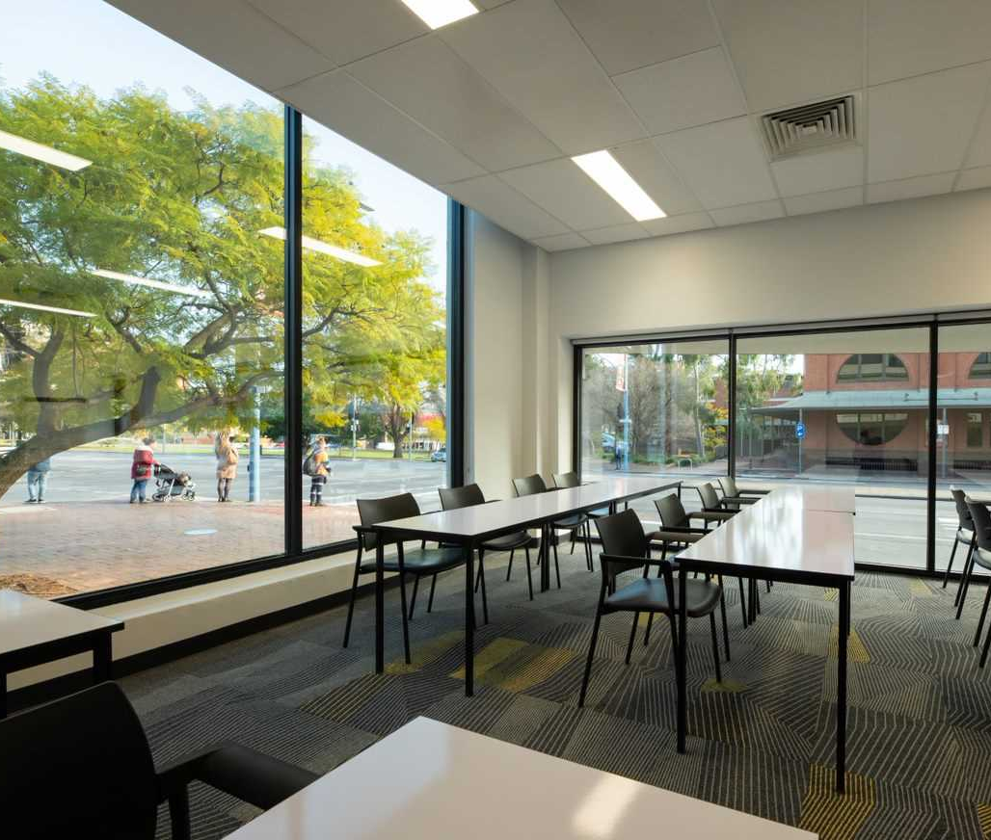

Slide 7

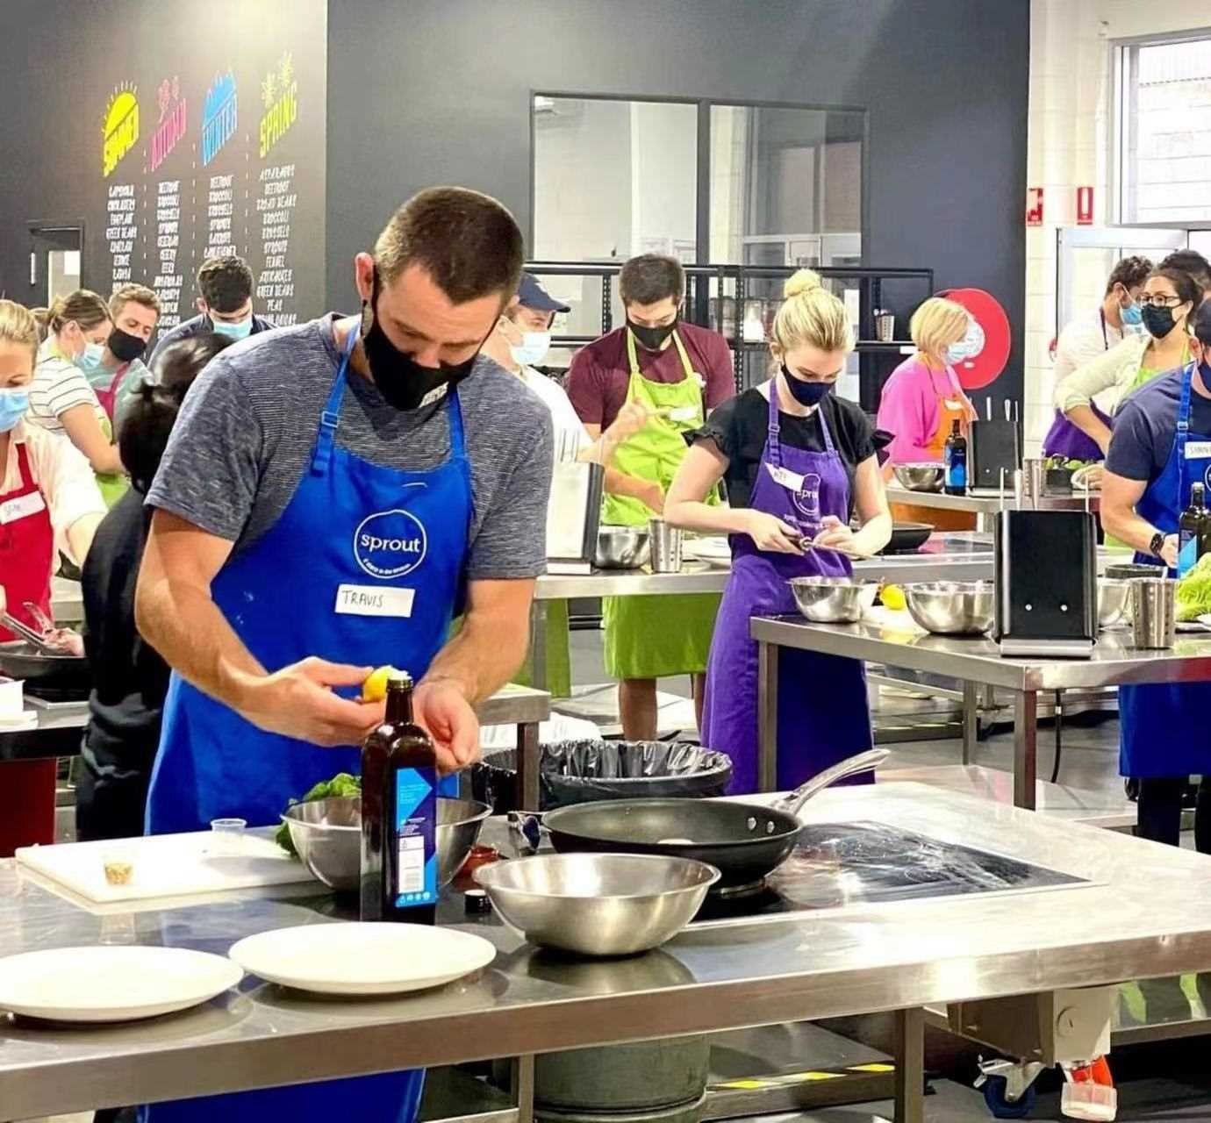


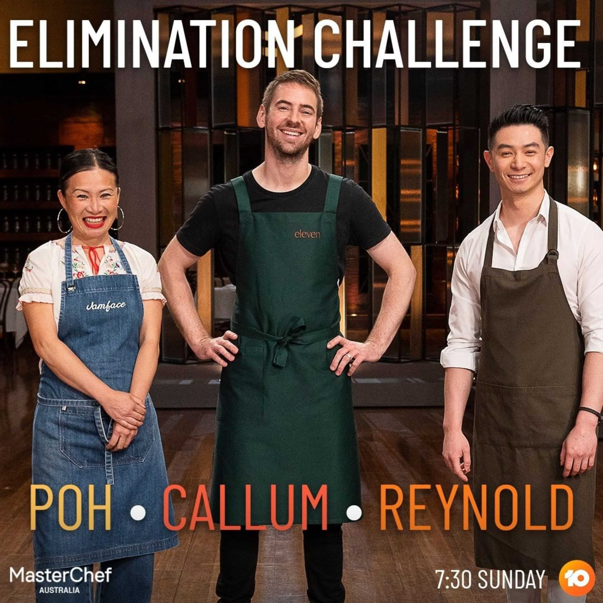
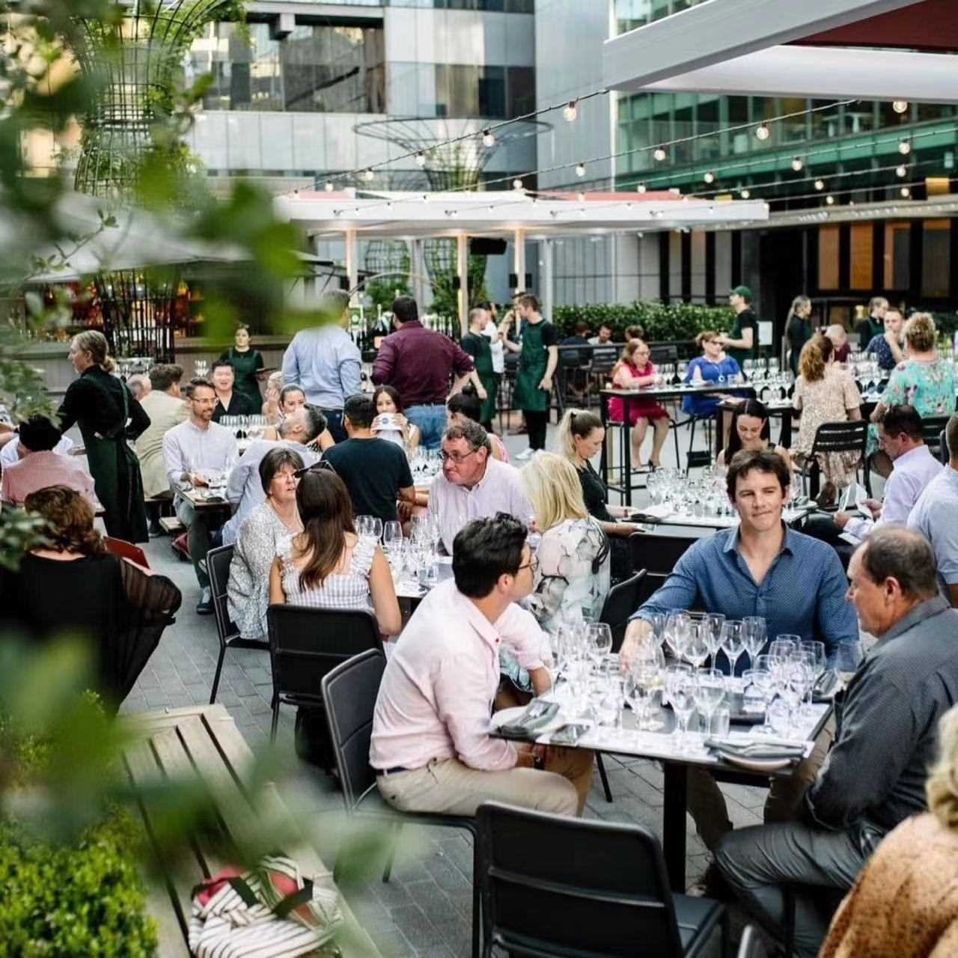

Industry Partnership with MasterChef’s
Callum Hann
Eleven, Adelaide
Sprout Cooking School

Slide 8
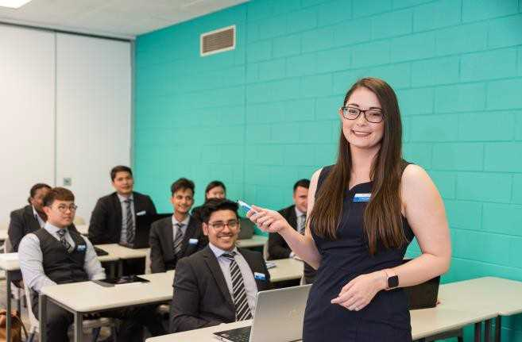

ICHM Study Abroad Program
An Amazing Australian Experience
Semester 1
Semester 2
On-campus Academic Study
20-22 Weeks
Off- campus Industry Placement
20-24 Weeks
6 Months Study in Adelaide
6 Months Paid Work Internship in Australia
Semester 1

Slide 9
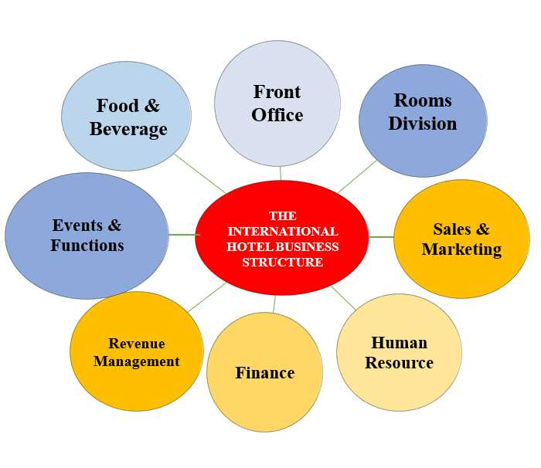
Semester 1
What Subjects will you be learning?
Delivering Guest Services Practicum
Food and Beverage Service Standards
Rooms Division Service Standards
The Contemporary Hospitality and Tourism Industry
These Subjects will provide you with the practical skills to work in the internship placements
9

Slide 10
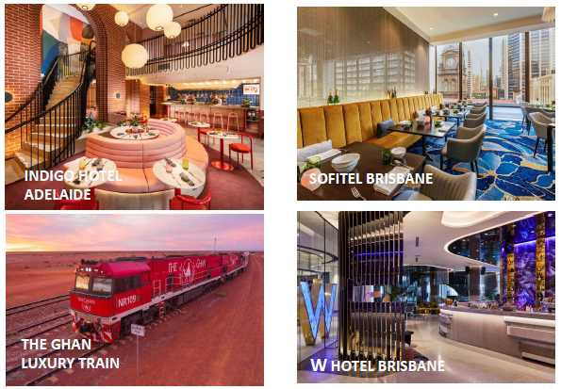
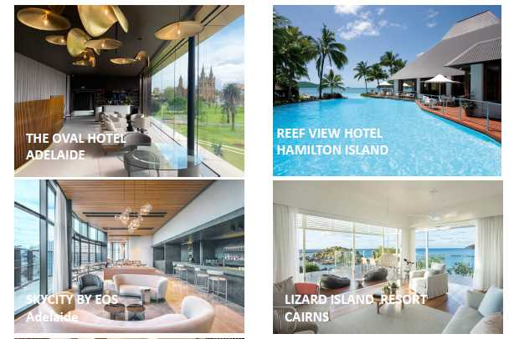
Semester 2
Amazing Work Placements Experiences
Amazing WIL placement and student experience each year of study

Slide 11












Gain Incredible Experience in Australia with International Hotel Brands

Slide 12
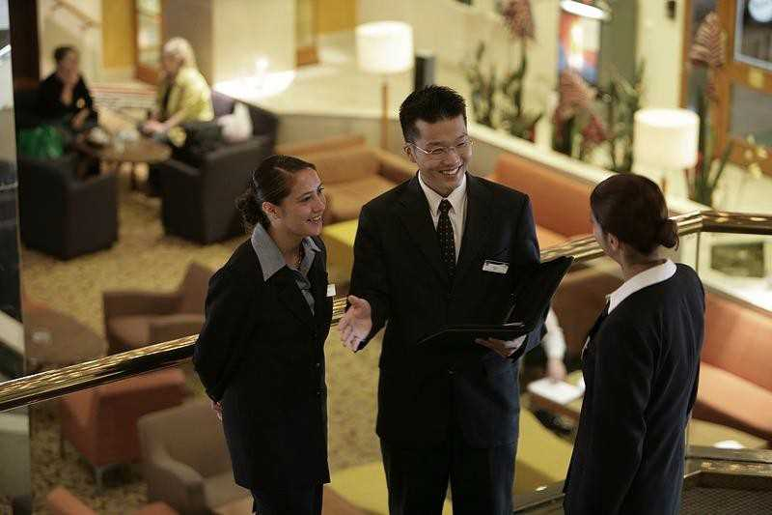
A People Business
Diverse Career Outcomes
Hotel Management | Food & Beverage Positions | Rooms Division Positions
General Manager | Food & Beverage Manager | Director of Operations
Revenue Manager | Event Manager | Rooms Division Manager
Sales & Marketing Manager | Restaurant Manager | Front Office Manager
Business Development Manager | Bar Manager | Reservations Manager
Gain Amazing Skills
Great Communication Skills
Great Problems Solving Skills
Great Customer Service Skills
Great Multi Tasking Skills
Public Relations Manager |  | Guest Relationship Manager
Human Resource Manager
Finance Manager
12

Slide 13
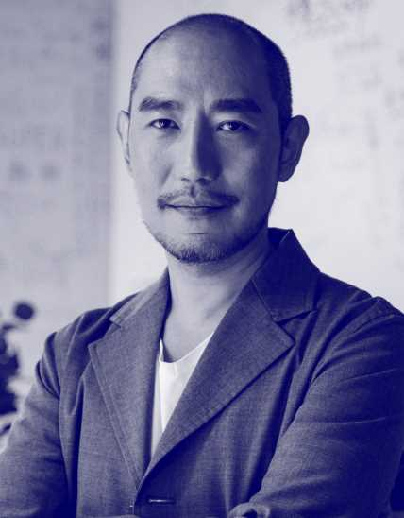

Entry Requirement for Study Abroad Program
Current university degree in related major
English requirement
  IELTS 5.5 (with no band below 5.0)
  TOEFL 60 (min 15 in each band)
  PTE 36 (writing and speaking not below 29)
13

Slide 14
Costs of Studying ICHM Study Abroad Program
 | Fees | Estimated Earning During WIL
New Student Fee | A$ 250 (non-refundable)
Tuition Fee (4 Subjects) | A$16,000 | $10,000 ~$18,000
WIL - Work Integrated Learning Placements proivded by ICHM Australia are usually paid
Students potentially earn A$20~25/hour
Students can work full time during WIL. Not limited to 20 hours per week
During academic semester, students can work 20 hours per week

Slide 15
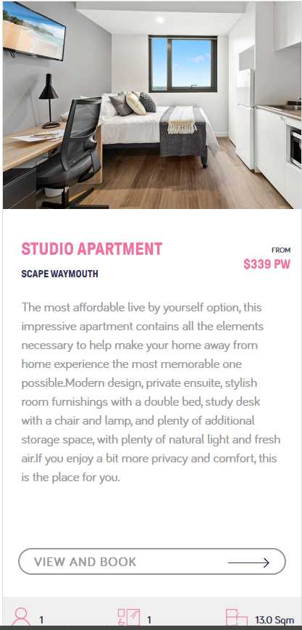
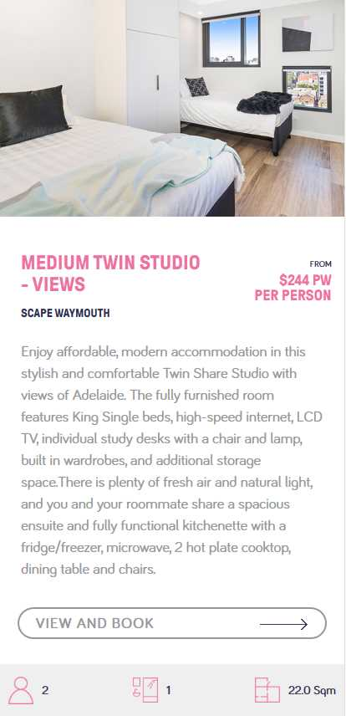
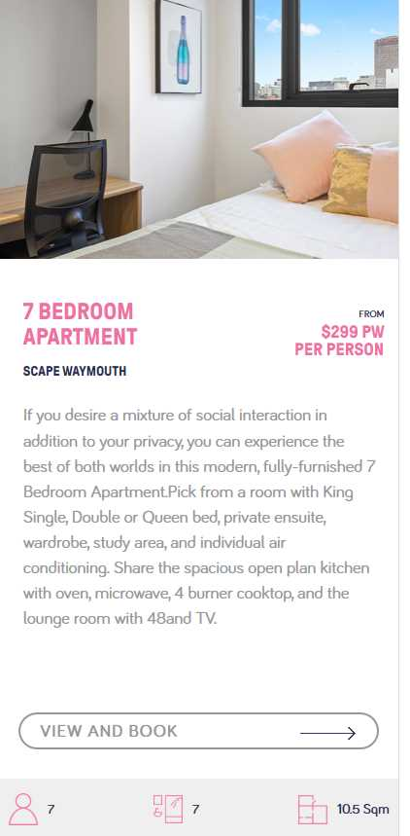
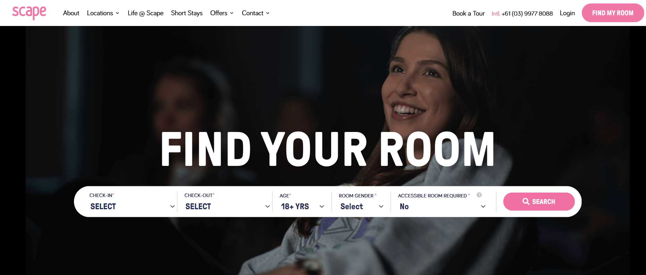
ICHM
New Accommodation:
Scape Waymouth
15

Slide 16
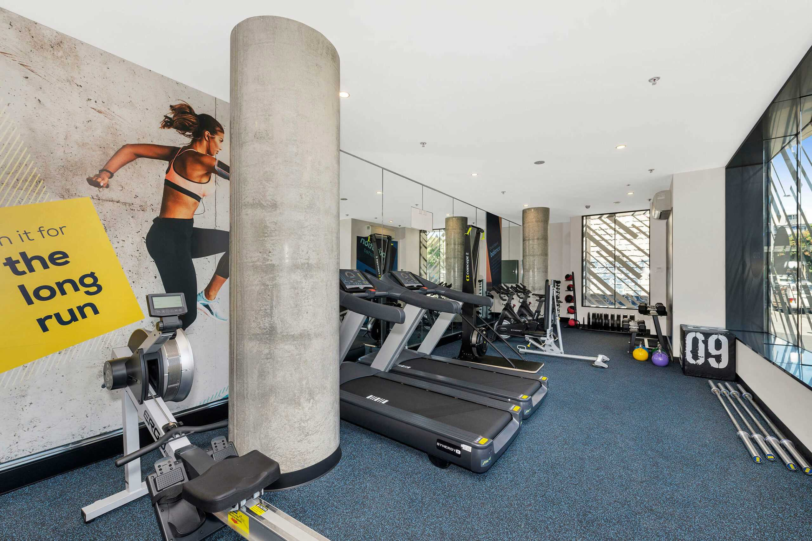
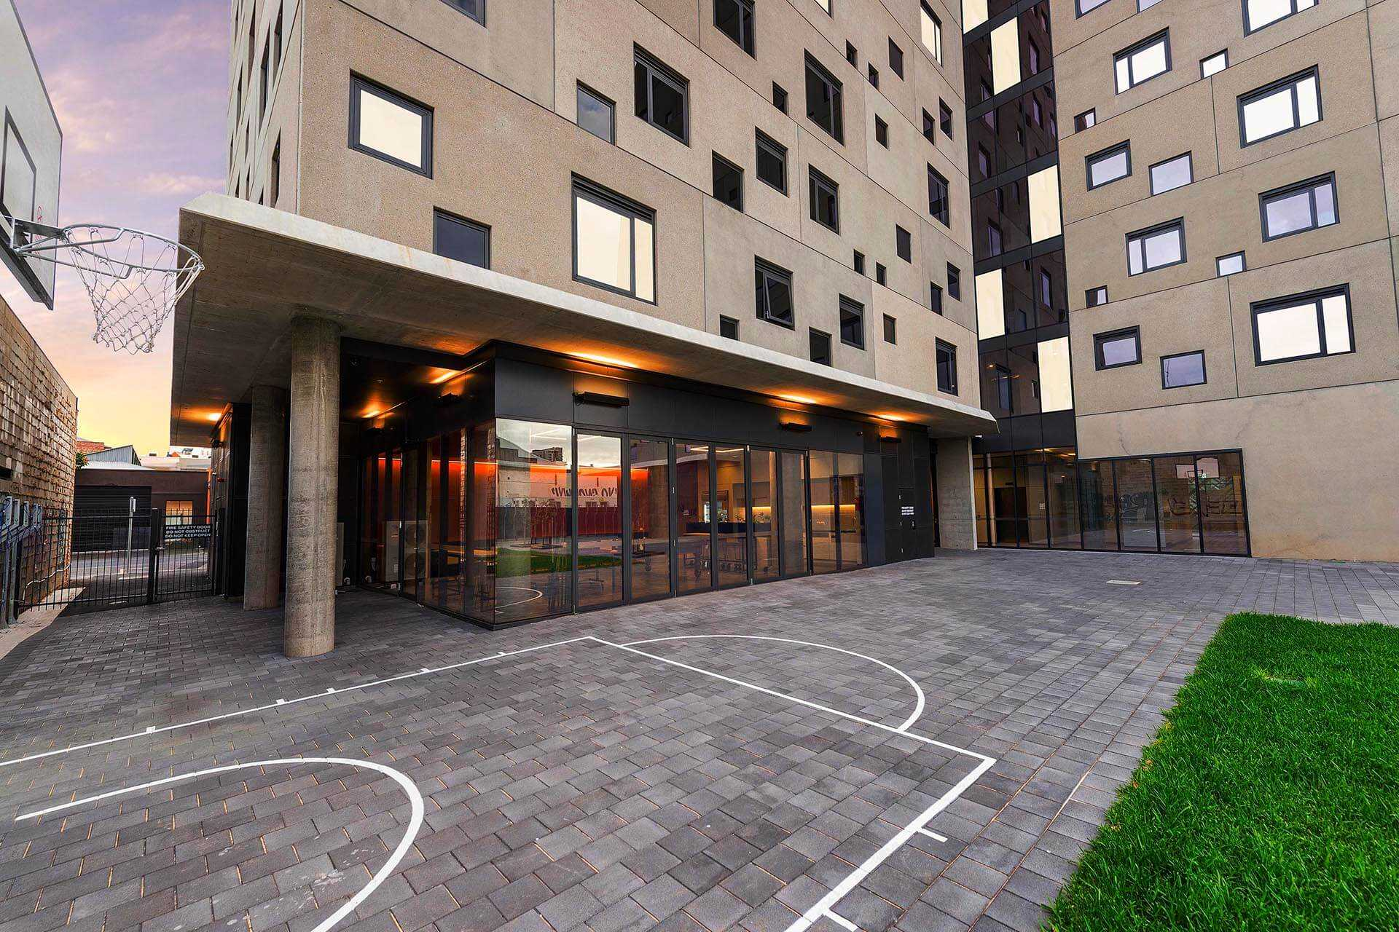
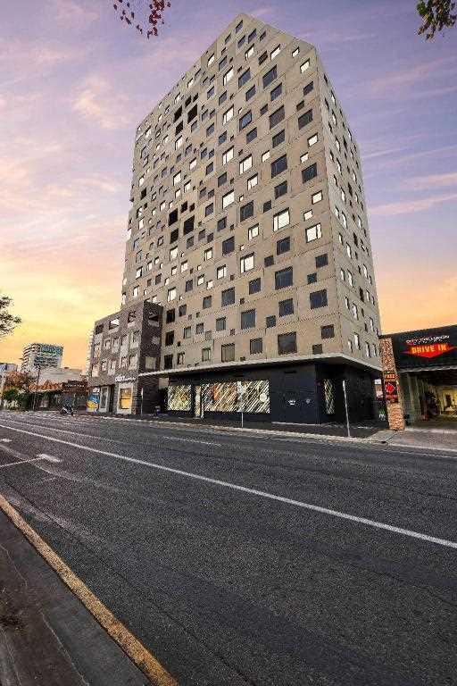
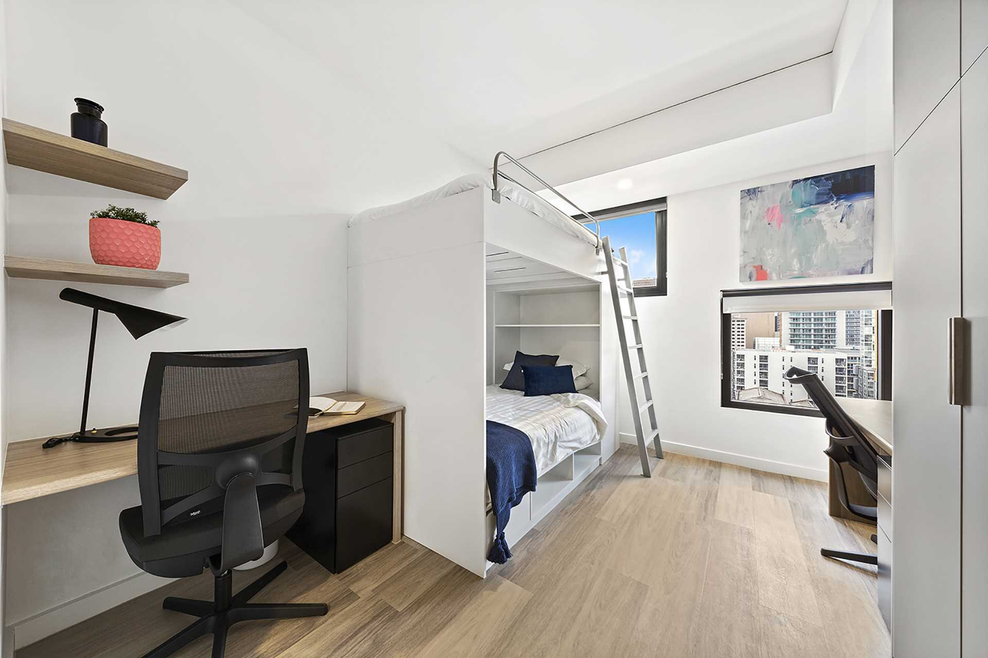
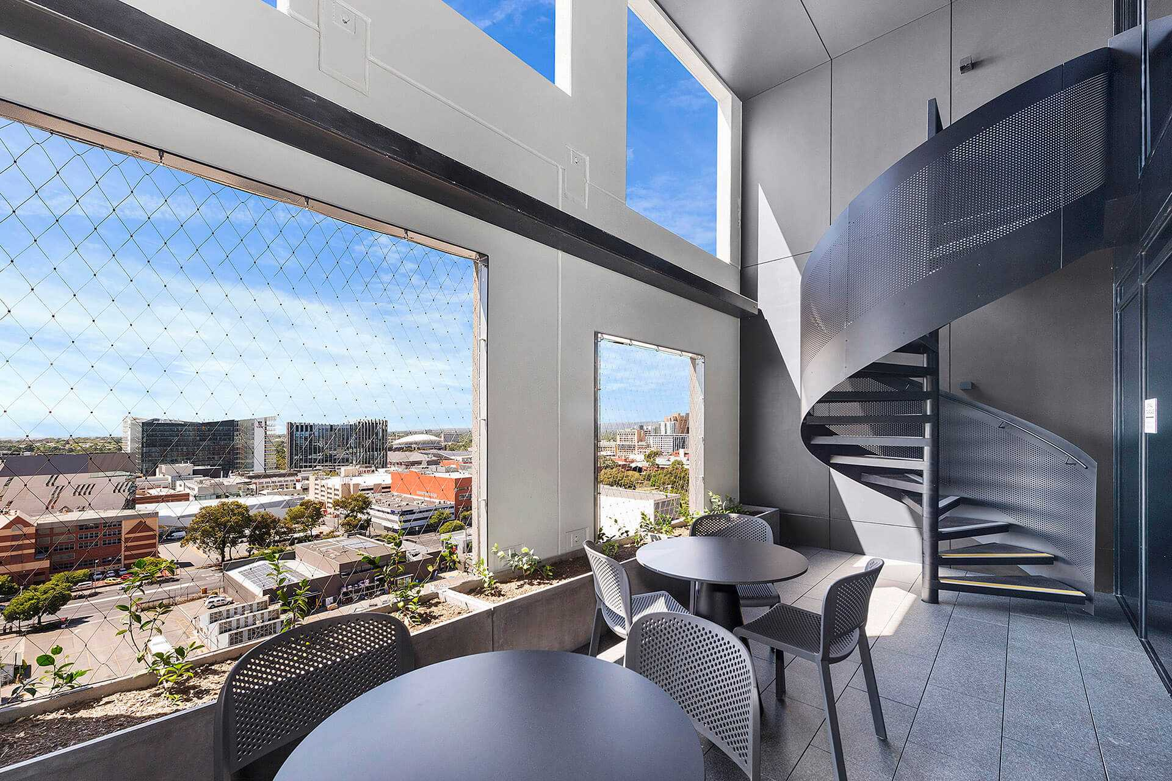
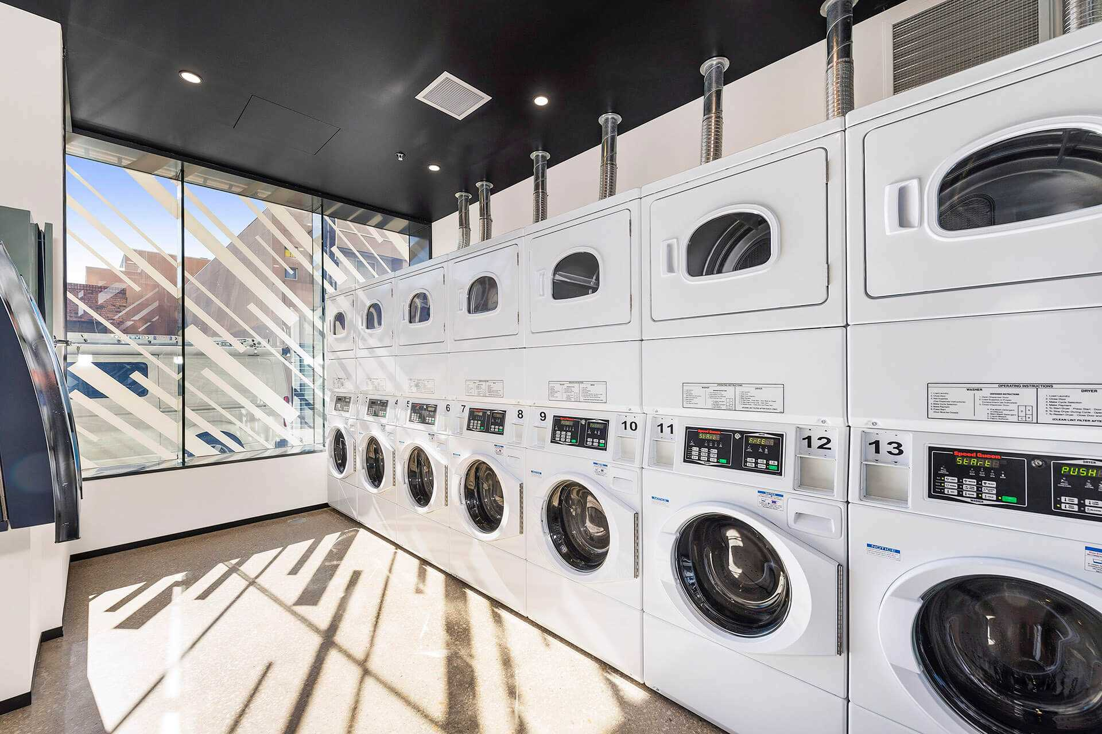
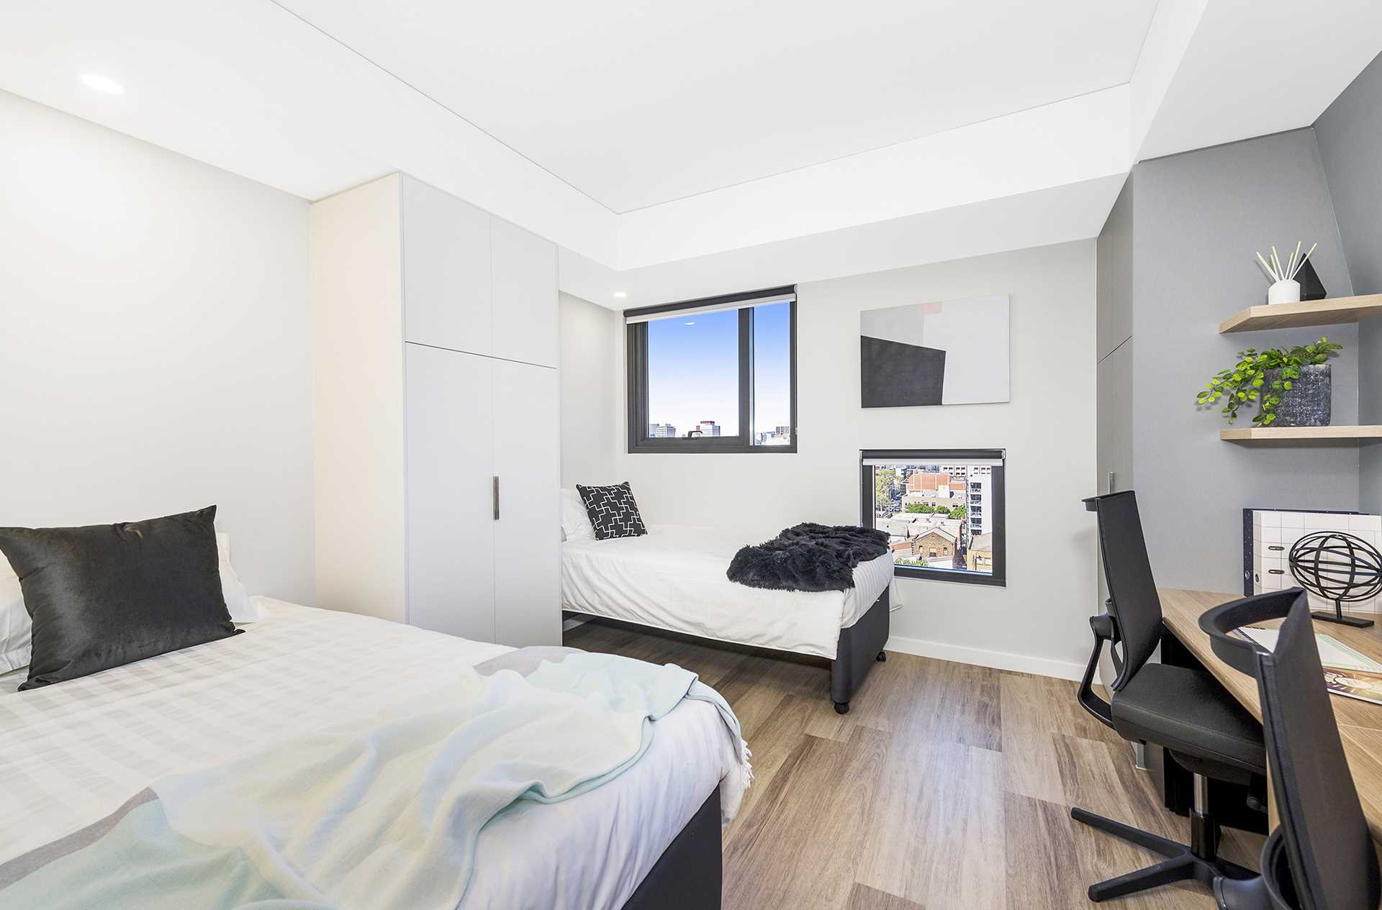
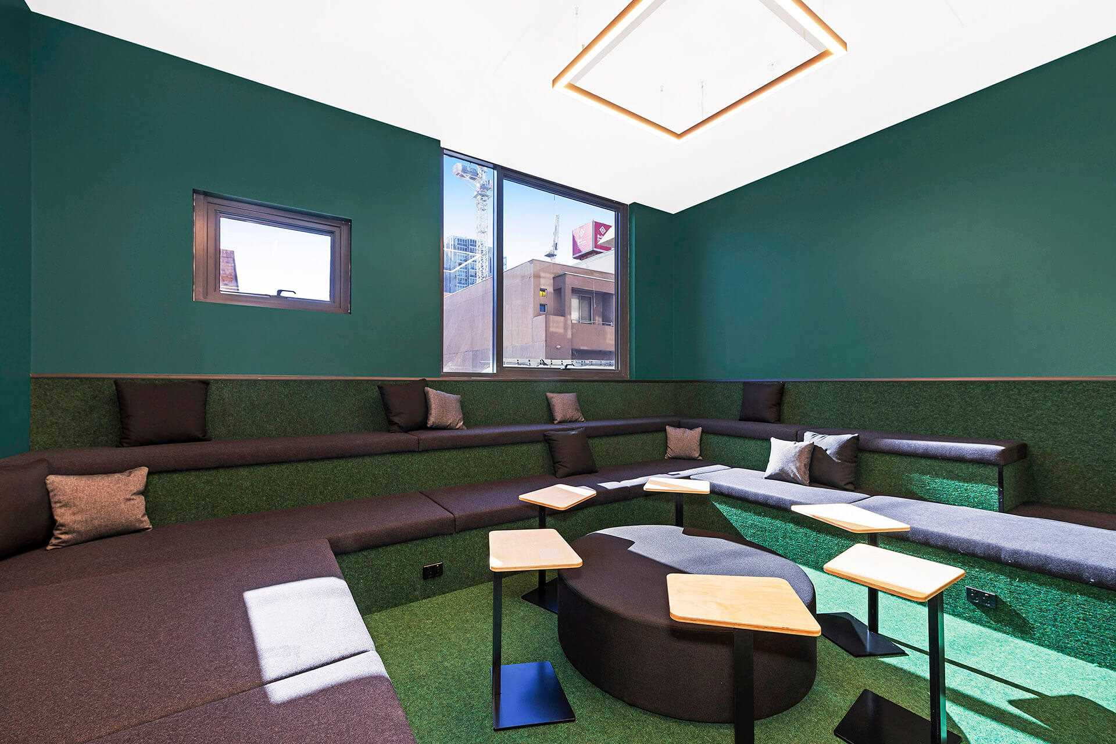
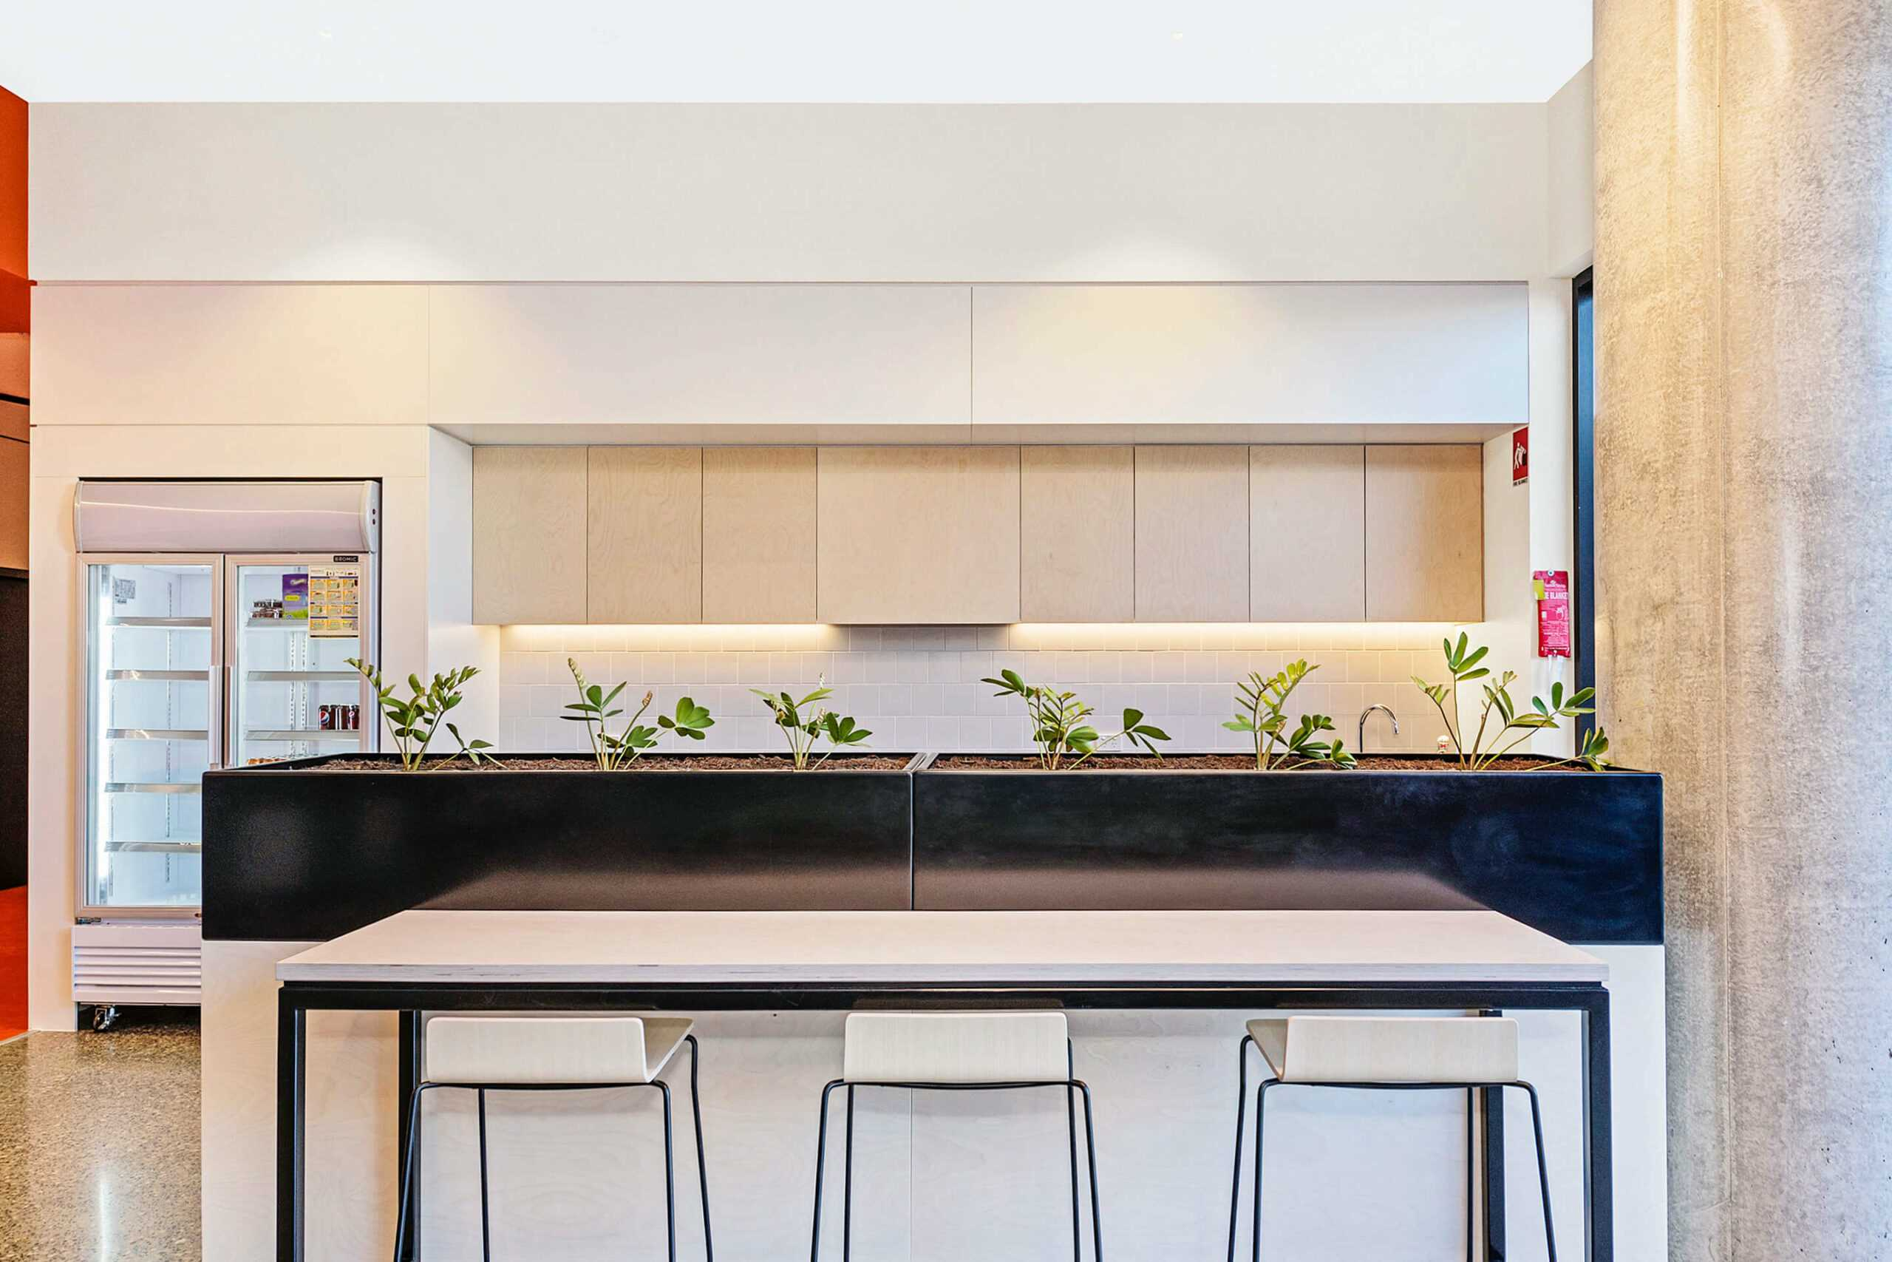
ICHM
New Accommodation:
Scape Waymouth
16

Slide 17
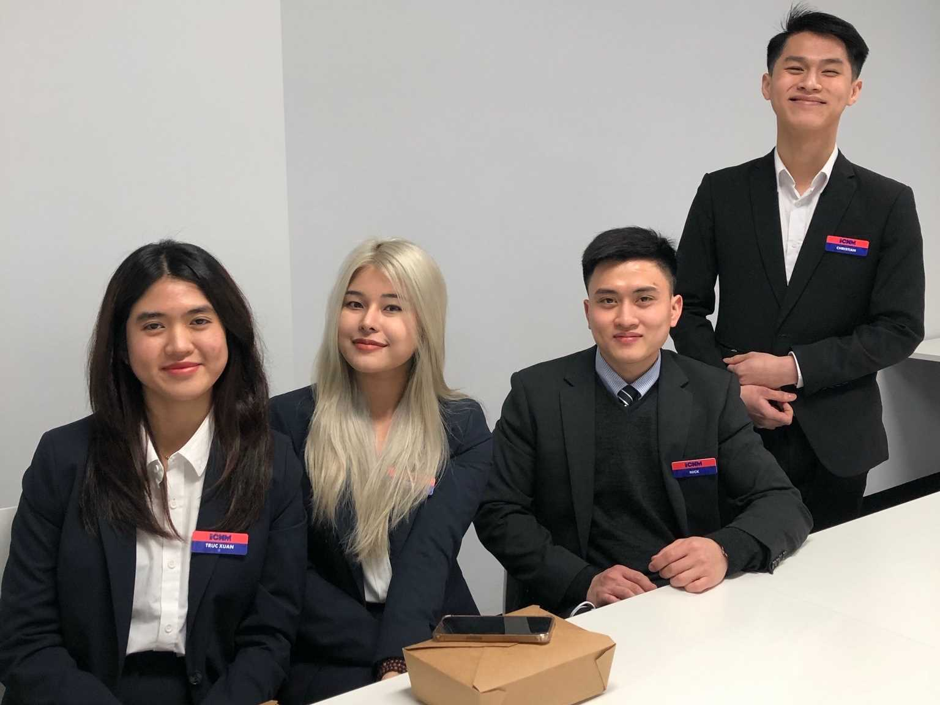

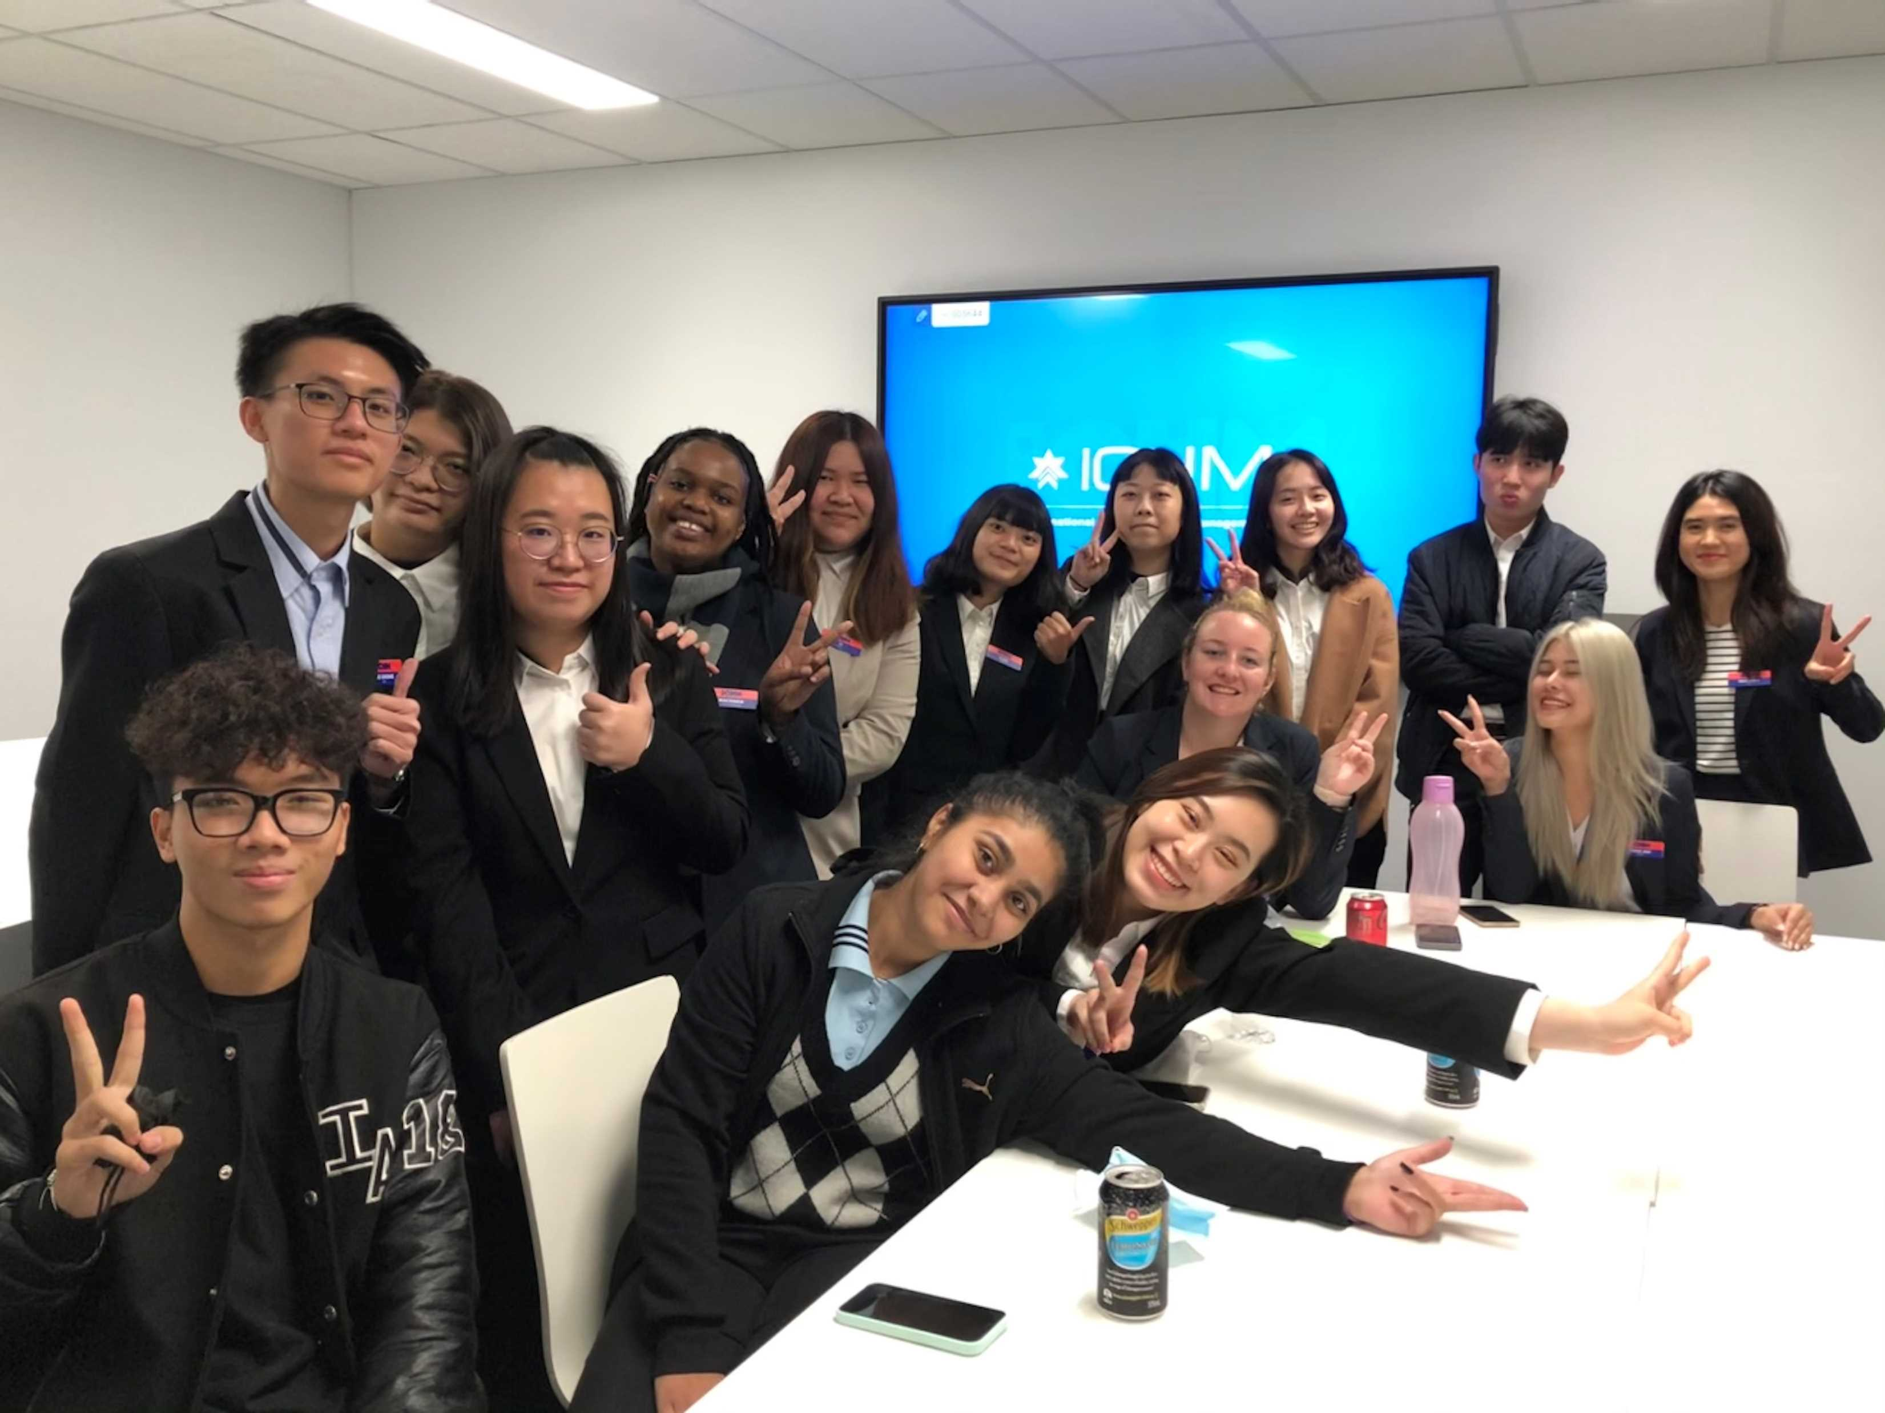
Students in ICHM

Slide 18
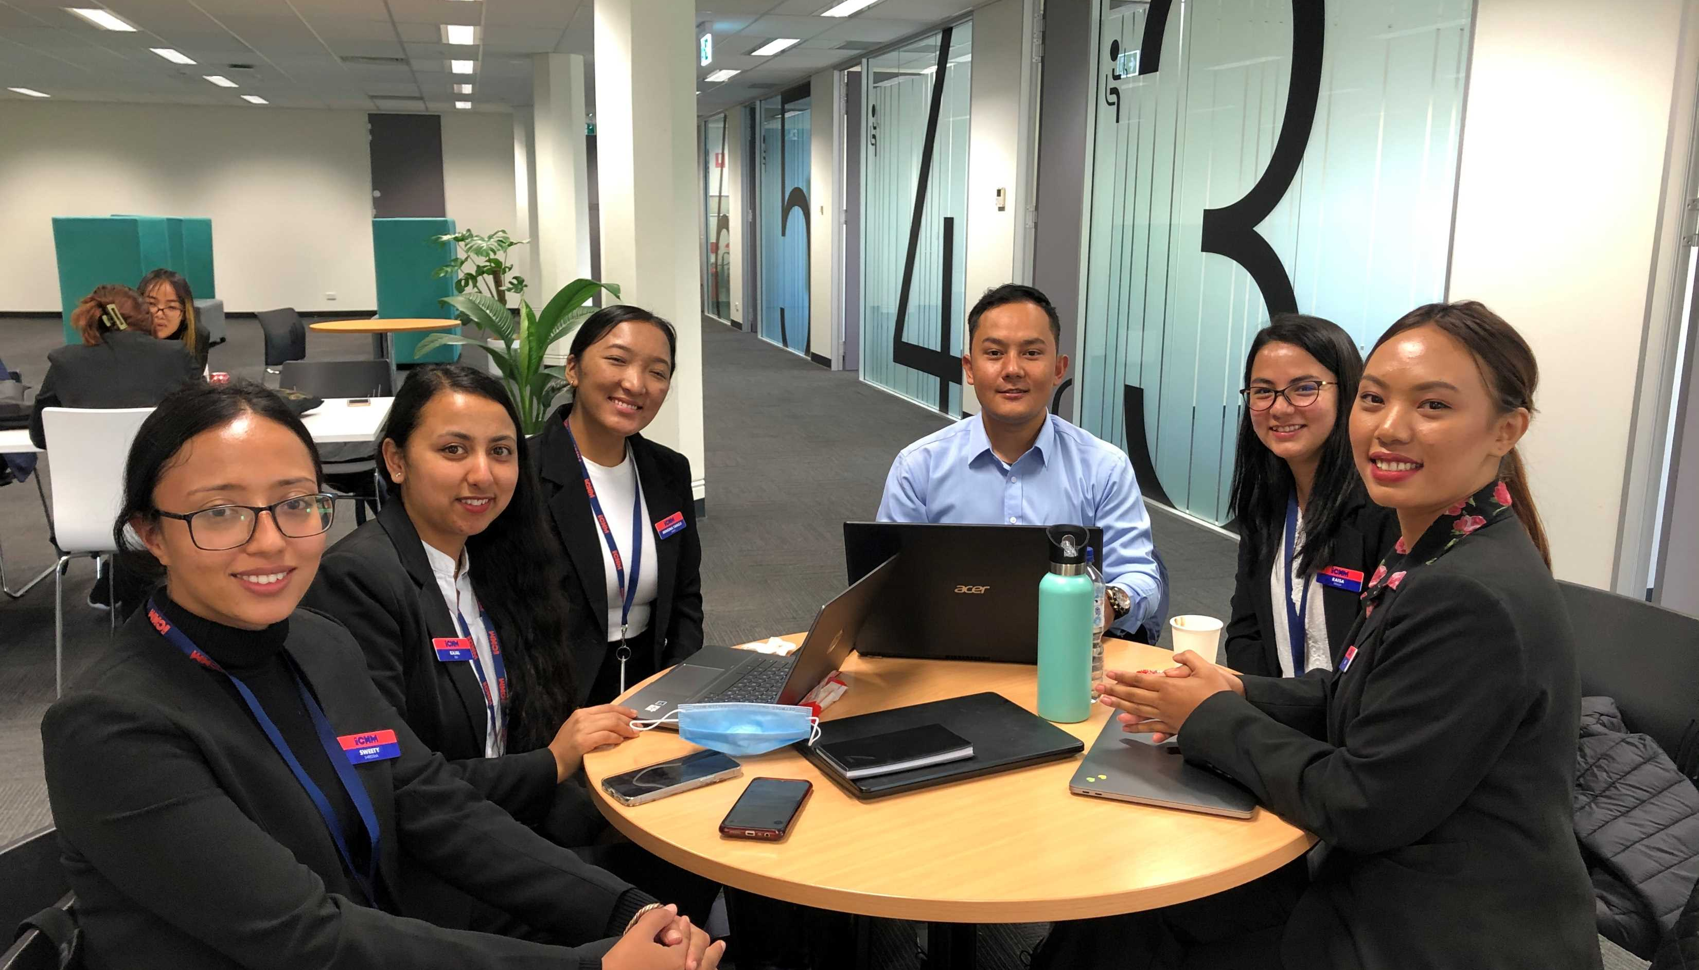
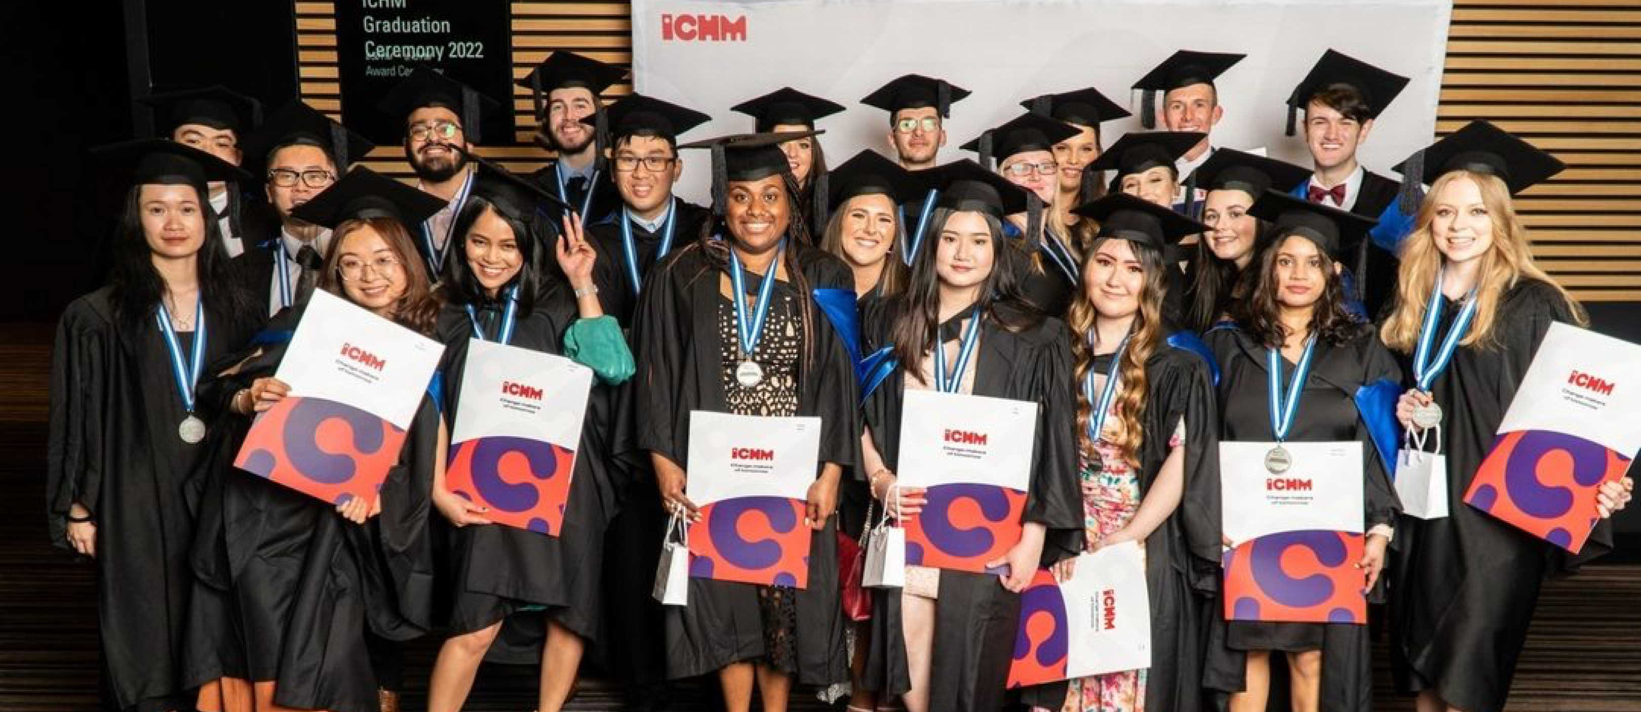
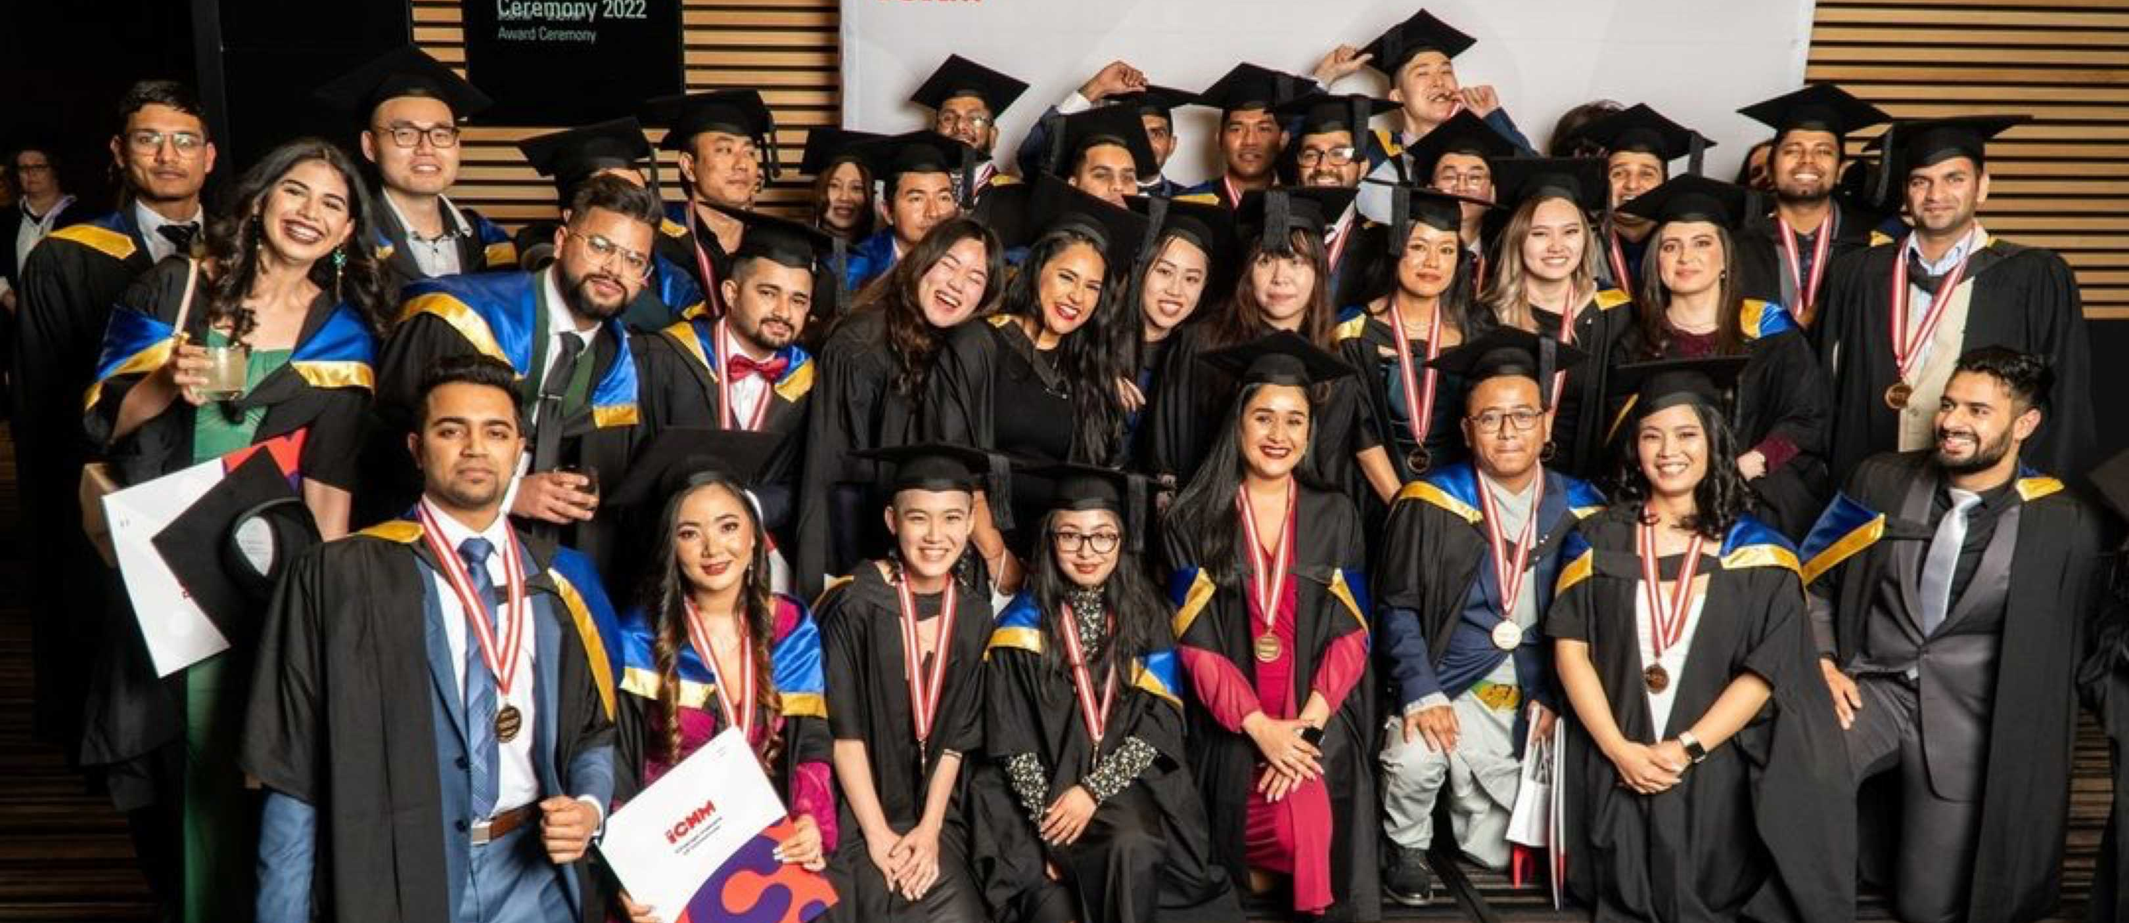
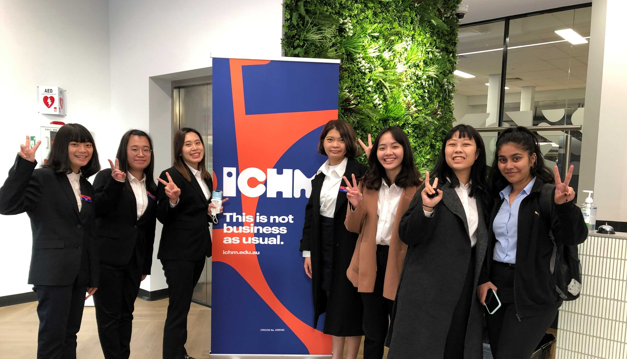

Slide 19

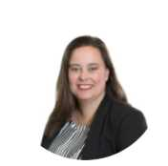
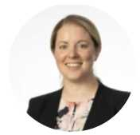
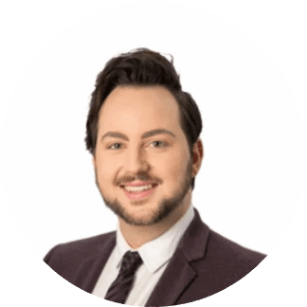
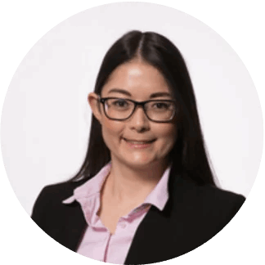
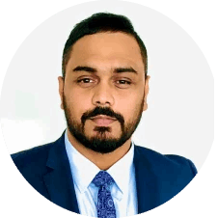
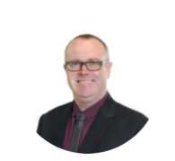
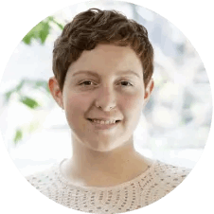
Our Industry and Career Development ( ICD) Team
Dr Sumi Ingerson
Program Director Academic Subject Areas: Event Management,Tourism Management,
Tharindu Attanayake (TAD)
Subject Areas: Accounting, Finance, Auditing & Economics.
Dr Nathan Crane
Program Coordinator
Subject Areas: Design
Dr Teagan Altschwager
Subject: Consumer behaviour, international marketing
Industry Background
Sumi comes to ICHM with over 10 years of knowledge and experience in teaching within a higher education environment. Through her time studying at the University of South Australia she has completed a Bachelors, Honours and PhD in the field of tourism, hospitality and events management. Sumi is currently completing a Graduate Certificate in Higher Education Academic Practice to further support her role as a Program Coordinator. As a member of the ICHM community, Sumi values Work Integrated Learning (WIL) and the use of authentic assessment principles as part of the curriculum.
Industry Background
Tharindu has over 12 years of experience spanning the financial and accountancy industry as well as academia in Australia and internationally.
As a passionate academic, Tad has extensive teaching and mentoring experiences to deliver the high-quality teaching and learning activities in both face to face and online platforms. He has previously taught subjects such as Introduction to Accounting, Economic Principles, Management and Cost Accounting, Auditing Principles and Information Technology for Businesses at Torrens University, and MIT Sydney.
Tad’s research passion lies in areas such as Crisis Management and Forensic Accounting
Industry Background
Dr Nathan James Crane is a design academic, writer and media consultant with 10 years of experience in the design and architecture industry.
Initially trained as an interior designer and stylist, he ran his own design agency, Nathan James Design Studio. Nathan is a widely published design writer and editor on titles including The Adelaide Review, FORM Journal, LUXURY and Marmalade magazines and a regular guest judge for design industry awards programmes.
He is currently Vice Chair of the Design Institute of Australia(SA/NT State Council).
Industry Background
Teagan's teaching and research interests are diverse, connected by a common theme of engaging consumers in unique and memorable experiences. Whether it's attendees of a winery event, customers in a retail/service environment, retirees consulting with their financial adviser, or students in a classroom, Teagan is interested in how carefully curated experiences can benefit both consumers and brands.
19

Slide 20
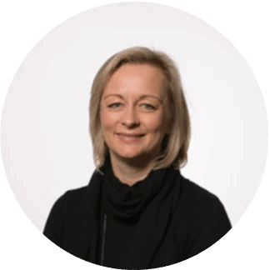
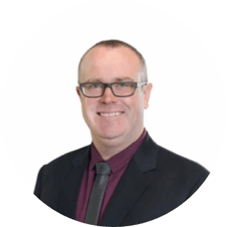


Academic Staff
Sophie Kinloch
Lecturer
Subject Areas: Rooms Division
Suzy Harmer
Lecturer
Subject Areas: Room Division
Lachlan Kelly
Lecturer
Subject Areas: Culinary
Moon Kang
Lecturer
Subject Areas: Food & Beverage
Industry Background
Sophie has had over 6 years experience in 5 star hotels of which 5 years were in Front Office at the Hotel George V in Paris and 10 years were in Housekeeping Management with the InterContinental Hotel Group (IHG).
Industry Background
Suzy has over 15 years Hotel Management experience in some of the UK's leading boutique hotels including:
The Metropolitan, London - COMO Hotels & Resorts Sanderson,
Morgan's Hotel Group, Hope Street Hotel, Liverpool
Hard Days Night Hotel, Liverpool.
She also worked as a:
Property Management System Installation and Training Specialist throughout the South Pacific
Installing and training Opera in some of Australia's leading resorts including working with Hyatt Hotels & Resorts, Radisson, Intercontinental, Stamford, Holiday Inn, Best Western
Industry Background
Lachlan has 20 years of experience working in the hospitality industry, predominantly as a chef, in a variety of international hotels both in Australia and in London. On completion of his university studies Lachlan worked as a brewer, distiller and winemaker, in both Australia and Germany.
Industry Background
Westin Sydney (Food & Beverage Manager) 2002 - 2008
W Seoul (Director of Food & Beverage) 2008 - 2011
Sheraton Maldives full Moon Resort & Spa, (Executive Assistant Manager) 2011 - 2012
InterContinental COEX & Grand InterContinental Seoul (Director of F&B) 2012 - 2016
Shangri-La hotel, Sydney (Director of Food & Beverage) 2016 - 2017
20

Slide 21




Our Alumni around the world
Rachael Harman
General Manager
Sofitel Adelaide, Australia
Graduated ICHM in 1999
Deidre Cotterill
General Manager
Cambria Hotel Downtown, Asheville, USA
GraduatedICHM in 2001
Mellissa Pitt-Chalmers
Vice President Of Global Sales
(Europe, Middle East & Africa)
Marriott International, London, United Kingdom
Graduated ICHM in 1997
Linda Girrbach
Director Of Revenue Management
Mövenpick Hotel, Berlin, Germany
Graduate ICHM in 2008
21

Slide 22




Our Alumni from Taiwan
Tina Huang
Assistant Front Office Manager
Renaissance Hotels, Taipei, Taiwan
Study Abroad program in 2013
Four Seasons Hotels and Resorts
Grace C.
General Manager
Hyatt, Taipei, Taiwan
Graduated ICHM in 2000
Sylvia Chu
General Manager
The Rocket Innovation, Taipei, Taiwan
Graduated ICHM in 1997
Crystal Chen
Community Sales Manager
Regus, Tokyo, Japan
Study Abroad program in 2015
InterContinental Hotels & Resorts
22

Slide 23








Study in Adelaide
“One of the world’s 10 most livable cities”
(economist Intelligence Unit 2018)

Slide 24






South Australia
The Wine Capital of Australia
An Ideal Place for Hospitality Studies
80% of Australia’s total premium wine production world famous regions such as the Barossa Valley, McLaren Vale, Adelaide Hills, Coonawarra

Slide 25

About Adelaide
The city designed for Life.
12% more affordable than Sydney
11% more affordable than Melbourne
Lowest median rent in Australia
50% discount on public transportation for all students
Afford more of the wonderful lifestyle that Australia has to offer

Slide 26

Tourism and Hospitality
Best performing state in hotel occupancy in Australia 2020
15th highest hotel occupancy rate in the world March 2021
1,900+ new hotel rooms recently completed or under construction
South Australian Visitor Economy Sector Plan 2030, is set to grow our visitor economy to $12.8 billion by 2030.
Generate an additional 16,000 jobs.
The Great Wine Capitals 11 cities in the world including Bordeaux (France), Lausanne (Switzerland), Mendoza (Argentina) etc

Slide 27


Student Wellbeing and Experience
Airport Welcome
Student Festival
Christmas Garden Party
Cultural celebrations
Community events
Employment skills webinars and workshops
Student Association Support
Student Newsletter latest information and events

Slide 28
Cost Estimation
Rental Fee | A$ Cost Per Week
Options | Total | Per Student
1 bedroom apartment | $200 - $300 | $200 - $300
2- or 3-bedroom apartment | $300 - $500 | $150 - $250
3 of 4-bedroom house | $450 - $600 | $150 - $250
Additional Cost | Estimated A$ Per Week
Food | $90 - $100
Utilities (gas, electricity, water, telephone) | $30 - $40
Laundromat | $10 - $15
Transport | $15 - $20
Household Requirements | $30
Personal (clothing, toiletries, entertainment) | $20 - $50
Other / Miscellaneous | $20 - $30
Total Weekly Estimate | $120 - $210
28

Slide 29

Follow us on our socials
29

Slide 30


Thank you.
Email: Joey.wang@up.education
Line: 0306joey
Instagram: onthewayjoey

Slide 31
What we offer:
• Local institution‘s Bachelor degree 3 years + ICHM Bachelor degree 2 year + ICHM Master degree 1.5 years
• Local institution‘s Bachelor degree 2 years + ICHM Bachelor degree 2 year ( into 3rd) year- Dual degrees
• One year Study Abroad program without degree articulation

Slide 32
Bachelor of Business (Hospitality Management)
BBHM106
Marketing and Sales for Hospitality Businesses
BBHM203
Supervising International Hotel Front Office Operations
BBHM205
Human Resource Management
BBHM206
Property, Safety and Security Management
BBHM209
Measuring Business Finance Performance
BBHM201
Supervising Culinary Operations
BBHM202
Professional Wine Studies
BBHM204
Creating the Guest Experience
BBHM207
e-Marketing and Distribution
BBHM208
Hospitality Operational Planning and Control
BIHM410
Gastronomy: The Art, Culture & Science of Food & Beverages
BBHM211a
Work Integrated Learning (WIL) placement
BBHM301
Managing Business Financial Performance
BBHM302
Managing Productivity Through People
BBHM306
Managing Food and Beverage Operations
BBHM307
Managing Rooms Division Operations
BBHM308
Sustainable Hospitality Environments
BBHM304
The Changing Economic Environment
BBHM310
Business Intelligence for Decision Making
BIHM402
Managing International Guests Expectations
BIHM405
International Hotel Brand Management
BIHM412
Event Management
BIHM414a
Art and Design in Hospitality Environments
BBHM211a
Work Integrated Learning (WIL) placement
BBHM101
The Contemporary Hospitality and Tourism Industry
BBHM102
Food and Beverage Service Standards
BBHM103
Delivering Guest Services Practicum
BBHM104
Rooms Division Service Standards
BBHM105
Culinary Techniques and Standards
BBHM108
Hospitality Business Software Applications
BBHM109
Employability Skills for Future Hoteliers
BBHM112
Essential Academic Skills for Success
BBHM111a
Work Integrated Learning (WIL) placement

Slide 33

MIHM101
International Hotel Food and Beverage Management
MIHM102
International Hotel Accommodation Management
MIHM103
Hospitality Management Accounting
MIHM104
International Hotel Services Marketing
MIHM201
Workforce Design and Strategy
MIHM202
Strategic Management
MIHM203
International Hotel Revenue Management
MIHM204a
Art and Design in Hospitality Environments
MIHM205
Information Systems Management
MIHM206
International Hotel Brand Management
MIHM207
Entrepreneurship and Innovation
MIHM209
Business Intelligence for Decision Making
MIHM301
Leadership in a Changing World
MIHM302
Hospitality Business in the Global Context
MIHM400
Professional Practice and Research Workshop
MIHM303
Ethics, Justice and Responsible Management in Hospitality
MIHM304
Hospitality Property Development and Management Strategies
MIHM305
International Human Resource Management
MIHM306
Managing Customer Relationships and Experiences
MIHM307
Research Methods for Managers
MIHM401
Master of International Hotel Management: Professional Practice & Research
Master of International Hotel Management

