Slide 1
2024/12/2 Junior Year Abroad Counseling and Reporting System
Department Assistant
林錦蓮(Tina)
2024/11/12 修訂

Slide 2
What does the system do?
Submit contact information
Register language test scores
Register study abroad university
Report accommodation status
Report course selection for the previous semester
Report adjustment to life and academics
Report plans for the winter break
Report course selection for the upcoming semester
Report return date to home country
Submit study abroad experience report
Apply for credit recognition for overseas courses
Before abroad
During abroad
After abroad

Slide 3
Where is the study abroad system？
Tamkang University -> Administrative Units -> General Education Center -> Junior Year Study Abroad -> Junior Year Study Abroad Counseling Notification System
Link：https://tku3rd.ais.tku.edu.tw/

Slide 4
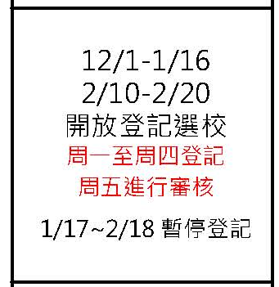
When can we start the register?
Registration period: December 1, 2024 - February 20, 2025 (Registration is paused during the winter break from January 17 to February 18)
Registration is available Monday through Thursday, with reviews taking place on Fridays.
Note: On Friday, Saturday, and Sunday, you can only save your progress temporarily. Submissions can only be made from Monday to Thursday.

Slide 5
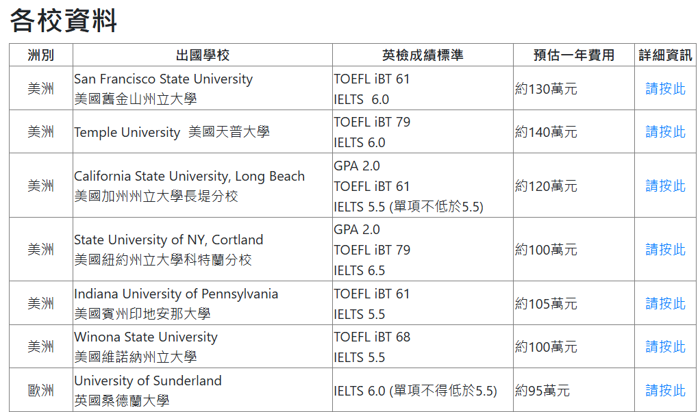
Where can I check the requirement？
Please go to 三全教育中心官網 to check「各校資料」
(e.g.)

Slide 6
Where can I check the quota for each school？
Please go to 三全教育中心官網 to check「最新消息-三全教育中心大三出國113學年度姊妹校門檻及申請名額公告」
(e.g.)

Slide 7
The process for application
Mon. to Thu.
Fri.
1.Submit your application
4.Application complete, please keep in touch with your counselor teacher
3.Announcement for the review status
2.Wait for the result
Approve
Disapprove
4.Release the quota. Apply again in the next Mon. to Thu.

Slide 8
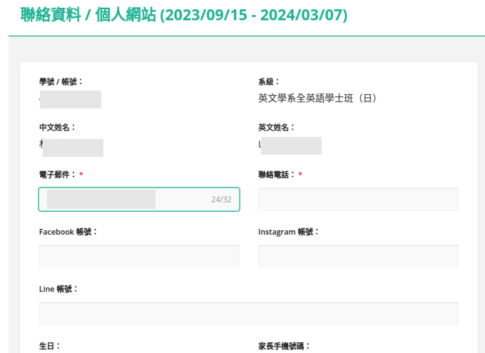
How to fill in the application？
Fill in your contact information first
「*」 is required
(e.g.)

Slide 9
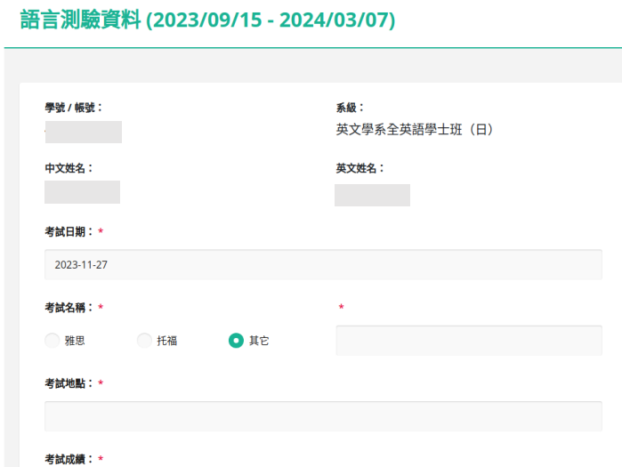
How to fill in the application？
Next is to fill in your language test result
「*」is required, you can only register the overseas school after you finish uploading the grades
(e.g.)

Slide 10
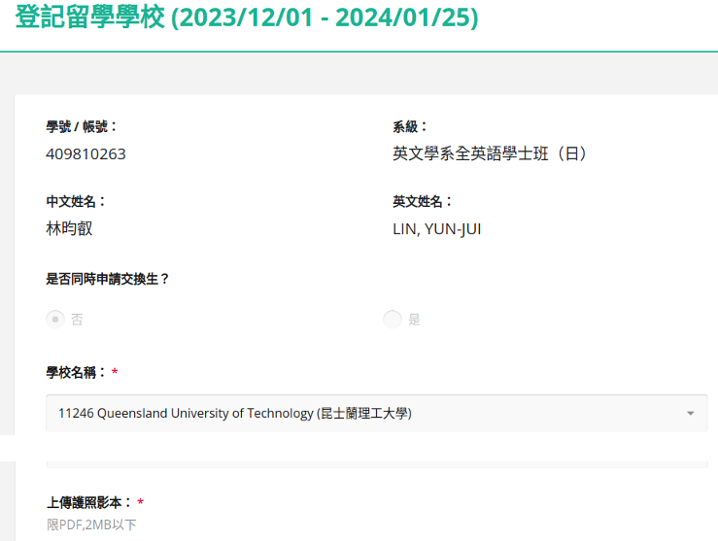
How to fill in the application？
Finally, you can choose the school you want to go
「*」 is required
(e.g.)

Slide 11
Attention!
Registration for schools is on a first-come, first-served basis each week. Registration will close once the slots are full. If any spots become available, they will be reopened during the next week's registration period.
Please ensure that your grades meet the requirements and are successfully uploaded before proceeding with registration. Disqualified language score is not allowed.
For language test scores, you may upload a screenshot of the test results via text message or online score report. The official transcript must be uploaded within the designated time. Failure to submit the official transcript on time will result in rejection.
For exchange students, please follow the International Office’s announced application schedule for paper applications. The system is not used for this application, but you may apply simultaneously.

Slide 12
How to check the result？
The review status will be shown on the first page of the system
(e.g.)

Slide 13
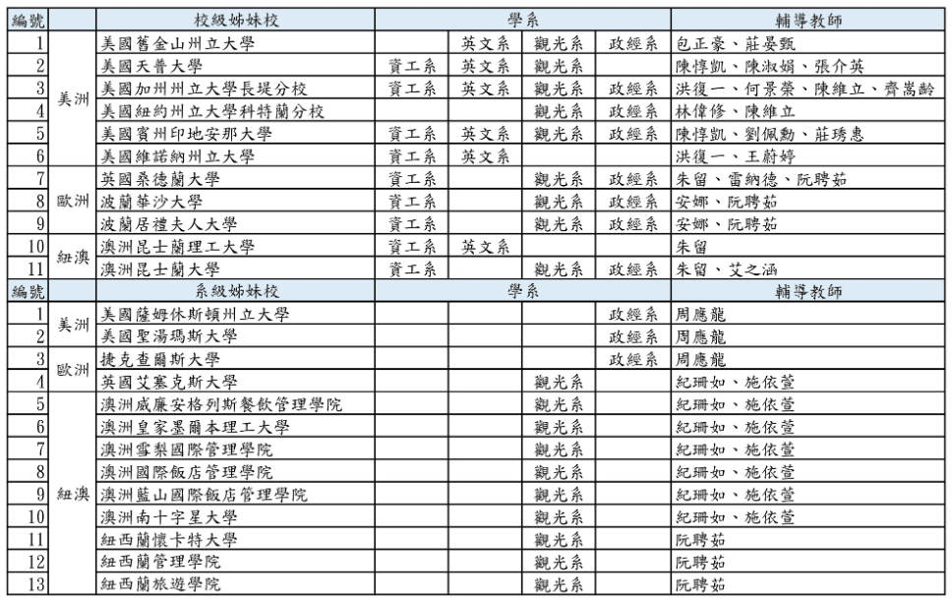
Who is my counselor teacher？
Please go to 三全教育中心官網 to check「2024 大三出國學校一覽」
(e.g.)

Slide 14
Where can I to check the available slots？
Please go to 三全教育中心官網 to check「最新消息」
The announcement will update every week
(e.g.)

Slide 15
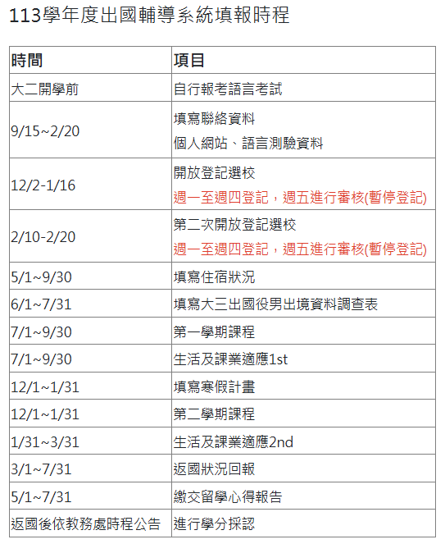
When should I report my status to TKU after going abroad?"

Slide 16
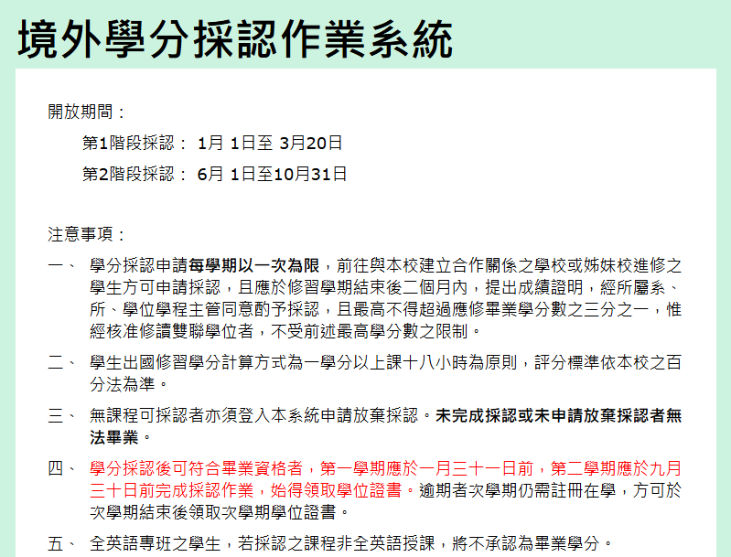
When can I start credit transfer？
Except for Senior students who wants to apply for Academic award can apply in first stage, other students should should apply during second stage
Senior students please submit no later than Sep 1st, to avoid graduation delay

Slide 17
Where is the credit transfer system？
Tamkang University -> Administrative Units -> General Education Center -> Junior Year Study Abroad -> Abroad credit recognition system
Link：http://163.13.121.55/CrApply

Slide 18
What should I prepare for credit transfer？
Before credit transfer
1.Have to complete feedback upload first
Documents you need to prepare
1.Syllabus(Required)
2.Transcript(Have to be official, Electronic transcript needs recognition, Hard copy needs to submit to Department office)
Example for Electronic transcript
Please apply 2-3 copies to avoid missing , apply credit transfer ASAP

Slide 19
What courses can I transfer？
Please check with cross-Reference Table

Slide 20
The process for application
1.Make sure what course you want to transfer
4.The result will be done in 3-5 weeks
3.Wait for review status
2.Report in the system
Approve
Disapprove
4.Correct the disapproval part and resubmit again
The process for give up application
2.Submit give up in the system
1.Make sure you want to give up whole year or one semester
3.It will shown「Study abroad in 114-1 or 114-2」on transcript

Slide 21
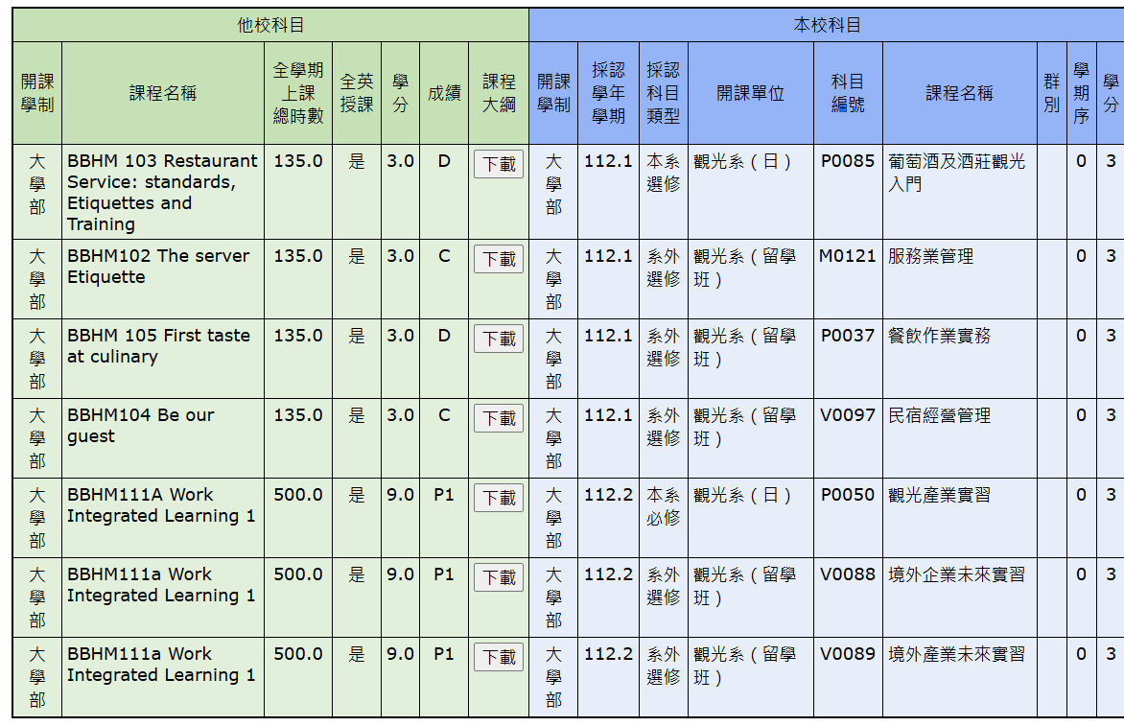
Attention!
Please fill in「是」in 「is it English taught」
Please fill in 「是」
Please fill in at least one course in each semester
Internship can transfer into 3 courses with 3 credit

Slide 22
Principles for transfer overseas credits
1.Overseas courses must be taught entirely in English and must not be language school courses.
2.Overseas credits can be recognized as required courses, elective courses, or general education courses, provided the course content matches.
3. Courses recognized as Tamkang University subjects do not need to be taught entirely in English, but you must select the "taught in English overseas" option in the system.

Slide 23
4. The number of credits for the course to be recognized must match or exceed the credits of the corresponding Tamkang course (e.g., 3 credits can replace 2, but 2 credits cannot replace 3)
3 credits replacing 2 credits -> OK
2 credits replacing 3 credits -> NO
Two 2-credit courses replacing one 3-credit course -> OK
One 4-credit course replacing two 2-credit courses -> OK
One internship course can replace up to three 3-credit courses.

Slide 24
5. The uploaded transcript must include the school’s official certification label in the electronic file. For paper copies, please provide additional proof to the department office. Screenshots from the internet are not acceptable.
Courses that have already been completed cannot be recognized again, and duplicate credits will not be counted.
6. The recognition of overseas credits can only be submitted once per semester. Once submitted, no changes can be made!
7. If credits are not recognized during the first phase, they can be submitted during the second phase for both semesters at once.

Slide 25
Attention for Postpone going abroad
Mindset: Maintain a sense of urgency as if you are graduating this semester. During your junior year, in addition to ensuring you complete all the credits required abroad to reach 128 credits, you must also finish all tasks before senior year graduation.
This includes all required courses, minimum department electives, internships, certifications, and the graduation threshold for language proficiency tests.

Slide 26
Attention for Postpone going abroad
Pay special attention: Junior students who postpone studying abroad do not have the same privileges as senior students (such as course priority for registration, the ability to take two physical education courses, etc.)
After returning from studying abroad in senior year, the process for recognizing overseas credits may cause a delay in receiving your diploma. You must sign an affidavit in order to apply for studying abroad.

Slide 27
Important Notice for Students with Military Service Obligations
The Holistic Education Center will conduct an online survey. Please submit the required documents according to the announced schedule.
In the past, some students discovered just before their departure that they hadn't yet reached the date when they were eligible to study abroad, and were blocked at the airport by customs.
If your flight date has been changed, please notify the Holistic Education Center. If the change in your application schedule causes you to miss your departure date, you will be responsible for the consequences.

Slide 28
Q&A

