Slide 1

Academic Year 114-2
ITM Internship Application Process
The internship is a key learning phase for ITM students.
It allows you to apply knowledge and gain valuable experience. This process will guide you from eligibility to performance evaluation. Please review each stage carefully to ensure successful completion.

Slide 2


Collaborative Internship Organizations
Hospitality Industry
維多利亞酒店 Grand Victoria Hotel
八里福朋喜來登酒店 Four Points by Sheraton Taipei Bali
大倉久和大飯店 The Okura Prestige Taipei
花蓮潔西艾美酒店 Le Meridien Hualien Resort
台北文華東方酒店 Mandarin Oriental, Taipei
台北萬豪酒店 Taipei Marriott Hotel
煙波大飯店股份有限公司-宜蘭館 Lakeshore Hotel Yilan
煙波大飯店股份有限公司-新竹都會館 Lakeshore Hotel Hsinchu Metropolitan
國泰萬怡酒店 Courtyard by Marriott Taipei Downtown
台北市林萬麗酒店 Renaissance Taipei Shihlin Hotel
台北君悅酒店 Grand Hyatt Taipei
台北寒舍艾美酒店 Le Meridien Taipei

Slide 3



Collaborative Internship Organizations
Travel Agencies
鳳凰國際旅行社股份有限公司 (半年全時全職)
Phoenix Tours International, Inc. (Full-time, 6 months)
上順旅行社 Top Tour Travel Agency Co., Ltd.
Convention & Exhibition
世貿南港展覽館(半年全時全職)
Taipei Nangang Exhibition Center (Full-time, 6 months)
人才天下有限公司 HWH Executive Consultant Limited
Aviation
環亞機場貴賓室(半年全時全職)
Plaza Premium Lounge (Full-time, 6 months)
內政部移民署國境事務大隊-桃園機場 (特殊合作最少須5人同梯報名)
National Immigration Agency, Border Affairs Corps –
Taoyuan International Airport
(Special program; minimum group enrollment of 5 participants required)
長榮航空(半年全時全職) EVA Air (Full-time, 6 month)

Slide 4

How to get Internship Credits?(Select one)
Completed 200 hours domestic internship
Completed overseas internship with a passing grade
Completed the course “Tourism Industry Internship”
(3-credit required course)
Completed credit recognition for the
“Tourism Industry Internship” course
Participated in the Employment Credit Program and completed a full-time and six-month internship

Slide 5









Internship Application Process
2.Application verification
and placement coordination
1.Submit internship application online
4.Contract signing prior to
internship commencement
3.Results announcement

Slide 6





Application timeline and document readiness
Apply for Summer vacation,
First semester internship
Apply for Winter vacation,
2nd semester internship
Submit internship application
form online
Submit internship application
form online
Application deadline: May 31
Application deadline: Nov. 30
Application verification
and Placement coordination
Application verification
and Placement coordination
Operation period: Early June
Operation period: Early December
Result Announcement
Result Announcement
Expected time: Late June
Expected time: Late December
Complete contract signing
Complete contract signing
Expected time: Before July
Expected time: Before January

Slide 7
Documents to prepare in advance for internship application
1.One ID photo
2.One autobiography
3.Grades of each semester (Please check the School Administrative Information System
and attach a screenshot)
4.International student needs to prepare ARC and work permit

Slide 8
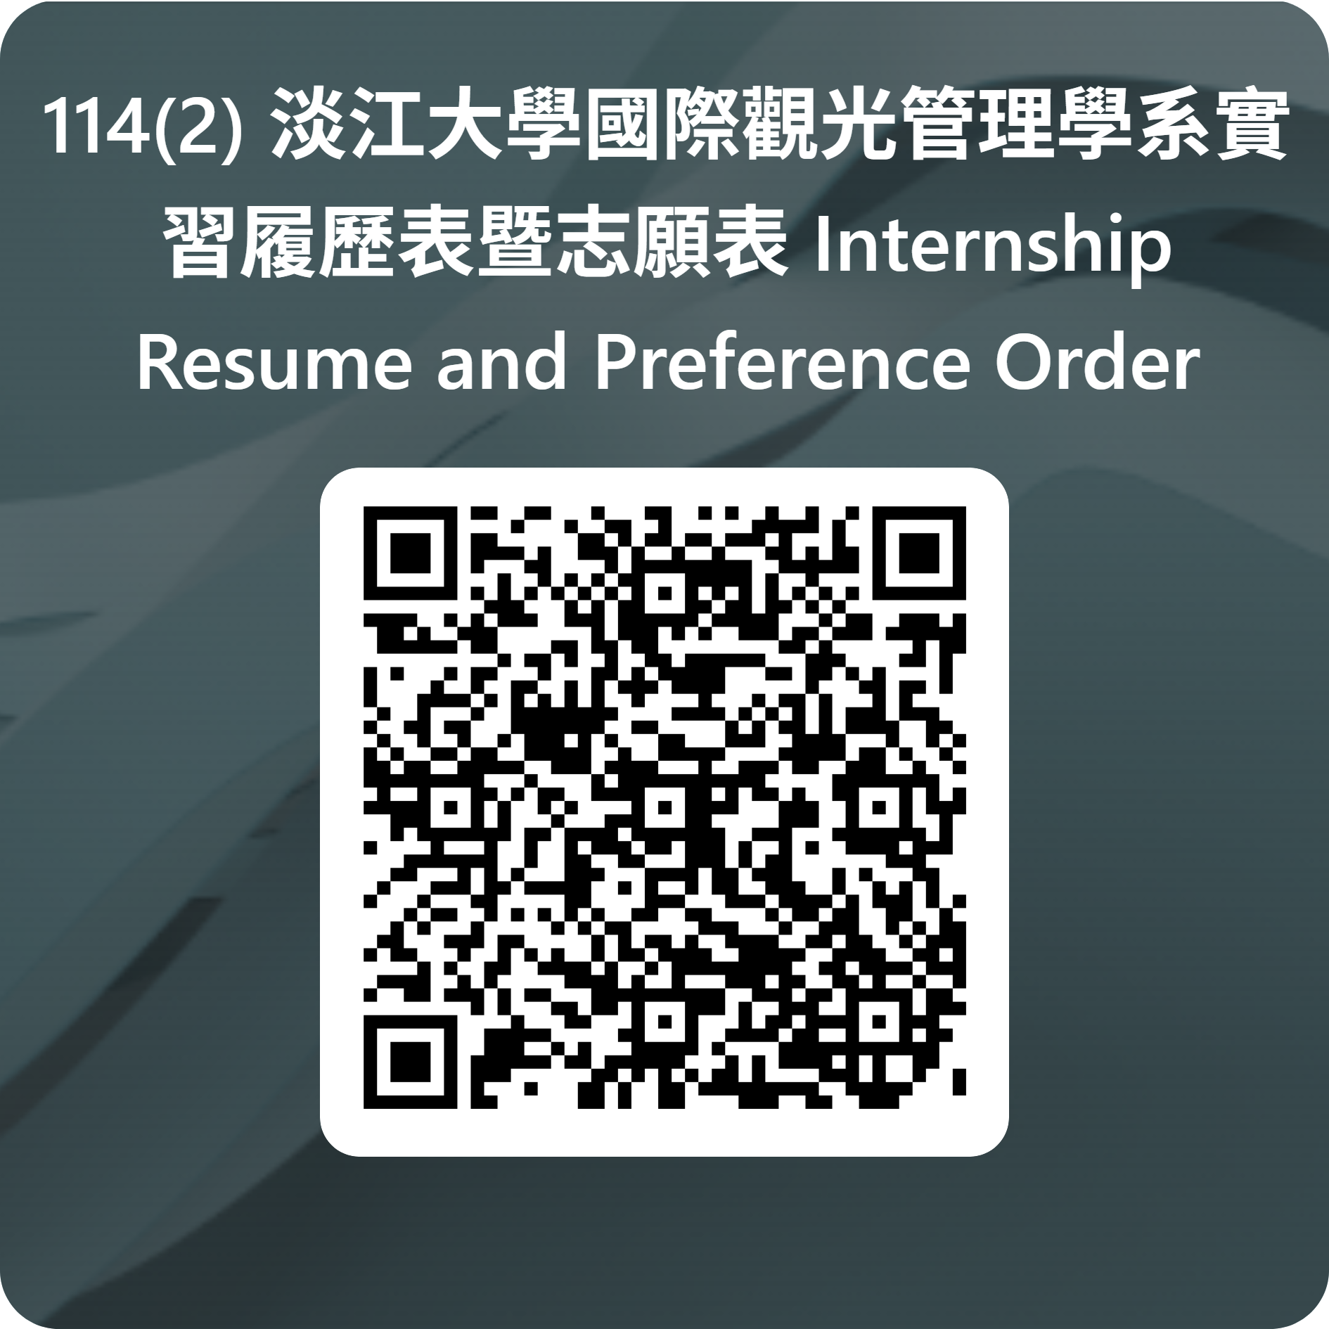
Internship Application Online Link
114(2) 淡江大學國際觀光管理學系實習履歷表暨志願表 Internship Resume and Preference Order Form of ITM – 填寫表單
Period for applying Summer vacation and 1st semester internship
System open: April 22 to May 31, 23:45
Period for applying Winter vacation and 2nd semester internship
System open: Oct. 31, to Nov. 30, 23:45
114(2) 淡江大學國際觀光管理學系實習履歷表暨志願表 Internship Resume and Preference Order Form of ITM – 填寫表單

Slide 9
Internship responsibilities and obligations
Abide by the rules
Strictly adhere to working hours, dress code, and confidentiality agreements.
Complete the internship Journals
Write 4 internship Journals, each in English with 500 words and at least 1 photo.
Distribute your learning evenly across the Journals.
Report an issue
Maintain contact with the teacher and report any difficulties in adjusting.
Submit the Evaluation form
Please have your supervisor fill out the Evaluation form
and submit it back to the school at the end of the internship.

Slide 10

Tourism Industry Internship Course
3 required credits in the second semester of the senior year.
Pass the internship Evaluation, and complete the internship sharing in class.
Submit all internship documents (contract, journals, evaluation form).
Please submit these documents before you take the class!
Complete all the above to pass the course.

Slide 11
Employment Credit Program (6-month internship)
Eligibility Requirements
1.Students in the junior year(inclusive) or above
2.Students with an overall score of
70 or above in their first and second years
Application Timeline:
Submit application in October
Complete interview &confirm placement in November
Submit the list to Academic Affairs in December
For more details, please refer to
the department's official website

Slide 12
Q&A
1. Q：Can I find an internship on my own ?
A：No, you can't get approval immediately like we used to do. You’ll need to go through the
internal review process, which takes at least six months to a year.
2. Q：Can I apply for the Employment Credit Program after completing an overseas internship?
A：Yes, you can. As long as you submit the required documents within the specified timeline.
3. Q：Do I submit paper or electronic copies of internship documents?
A：Submit paper copies and provide electronic files of the journal photos.
4. Q : Is the tourism industry internship course considered complete after finishing 200 hours of
internship?
A : No, the Tourism Industry Internship is a required senior-year course. It is only considered
complete after finishing the internship, submitting all required documents, and attending
the course.

Slide 13
Thank you！

